Slide 1
Introduction
Flux Tutorial at ECP Annual Meeting, Feb 6, 2020
Dong H. Ahn

Slide 2
Today’s Agenda
Time | Topic | Presenters
08:30AM – 09:00AM | Flux: Next-Generation Resource Management and Scheduling Infrastructure for Exascale Workflow and Resource Challenges | Ahn
09:00AM – 09:30AM | Flux APIs | Herbein
09:30AM – 10:00AM | Using Flux for scheduling MuMMI | Di Natale
10:00AM – 10:30AM | Coffee break
10:30AM – 12:00PM | Hands-on exercises | Herbein, Ahn and Milroy
12:00PM – 01:30PM | Lunch
01:30PM – 01:50PM | Using Flux to improve the usability, performance, and software complexity of UQP | Ahn
01:50PM – 02:05PM | Manage internal queue w/ Flux for common workflows | Agelastos (SNL)
02:05PM – 02:25PM | Flux with Kubernetes | Milroy
02:25PM – 03:00PM | Hands-on for advanced topics | Herbein and Ahn
03:00PM – 03:30PM | Coffee break
03:30PM – 04:00PM | Graph-based resource model and tiered storage support | Ahn and Herbein
04:00PM – 04:30PM | Makeup time for hands-on | Ahn and Herbein

Slide 3
Flux: Next-Generation Resource Management and Scheduling Infrastructure for Exascale Workflow and Resource Challenges
Flux Tutorial at ECP Annual Meeting, Feb 6, 2020
Dong H. Ahn, Ned Bass, Albert Chu, Jim Garlick, Mark Grondona, Stephen Herbein, Joseph Koning, Tapasya Patki, Thomas R. W. Scogland, Becky Springmeyer, and Michela Taufer

Slide 4
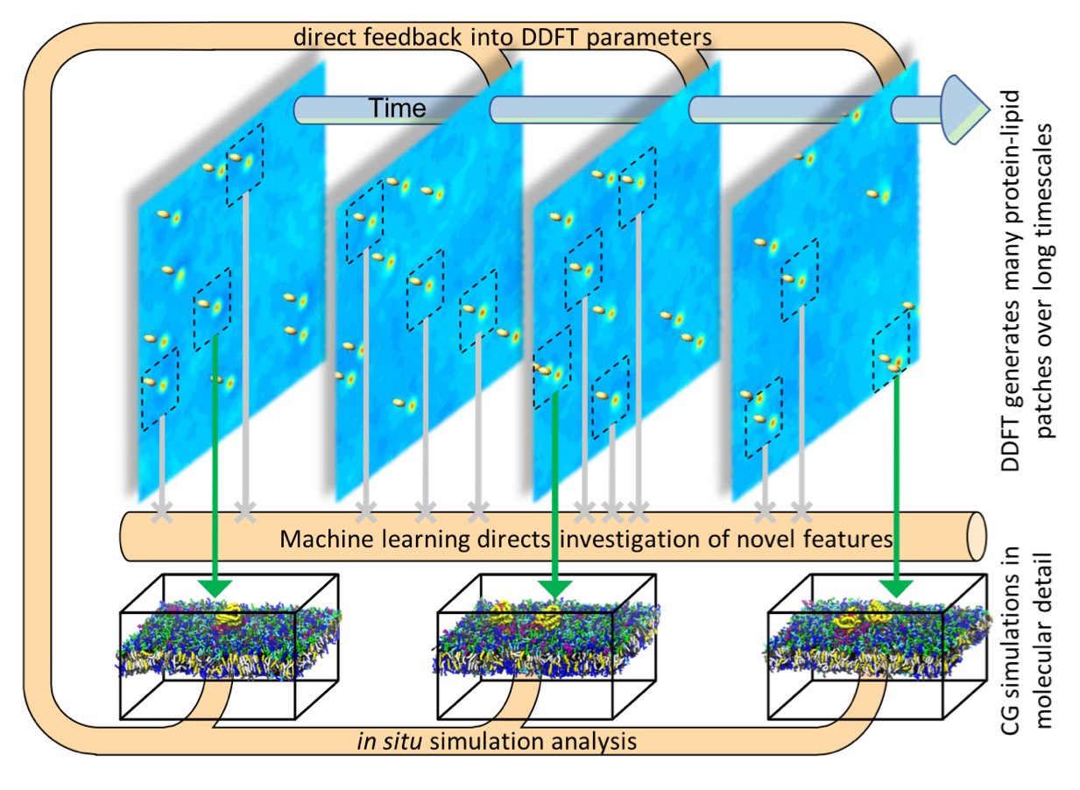
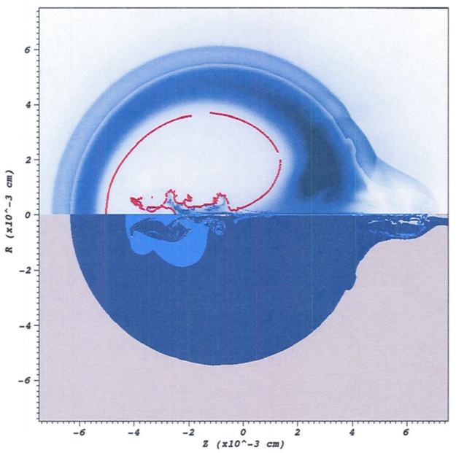

Workflows on high-end HPC systems are undergoing significant changes.
New pillar
Machine learning to compare
simulation and experiment
Traditional pillar
high-performance computing
Improved prediction
Deep neural network
HYDRA simulation
NIF X-ray image
Complete simulation and experiment data
Cancer Moonshot Pilot2 – co-schedule many elements and ML continuously schedules, de-schedules and executes MD jobs.
In-situ analytics modules
~7,500 jobs simultaneously running
Machine Learning Strategic Initiative (MLSI) – 1 billion short-running jobs!
Similar needs for co-scheduling heterogenous components

Slide 5

Key challenges in emerging workflow scheduling include…
New pillar
Co-scheduling challenge
Job throughput challenge
Job communication/coordination challenge
Portability challenge

Slide 6
Flux provides a new scheduling model to meet these challenges.
Allocated Resources
Flux Instance
Depth-1
Node
Node
Node
Node
Flux Instance
Flux Instance
Flux Instance
Flux Instance
Depth-2
C
C
C
C
C
C
C
C
C
C
C
C
C
C
C
C
C
C
C
C
C
C
C
C
C
C
C
C
C
C
C
C
Depth-3
C
C
C
C
C
C
C
C
C
C
C
C
C
C
C
C
C
C
C
C
C
C
C
C
C
C
C
C
C
C
C
C
Our “Fully Hierarchical Scheduling” is designed to cope with many
emerging workload challenges.

Slide 7
Flux is specifically designed to embody our fully hierarchical scheduling model.
Techniques
Challenges
Job Queue
Co-scheduling challenge
Job throughput challenge
Job communication/coordination challenge
Portability challenge
A
B
C
D
E
F…
Scheduler Specialization
Scheduler Parallelism
Rich API set
Consistent API set
Flux framework

Slide 8
Scheduler specialization solves the co-scheduling challenge.
Traditional approach
A single site-wide policy being enforced for all jobs
No support for user-level scheduling with distinct policies
Flux enables both system- and user-level scheduling under the same common infrastructure.
Give users the freedom to adapt their scheduler instance to their needs.
Instance owners can choose predefined policies different from system-level policies.
FCFS/backfilling
Scheduling parameters (queue depth, reservation depth etc)
Create their own policy plug-in

Slide 9
Scheduler parallelism solves the throughput challenge.
The centralized model is fundamentally limited.
Hierarchical design facilitates scheduler parallelism.
Deepening the scheduler hierarchy allows for higher levels of scheduler parallelism
Implementation used in our scalability evaluation:
Submit each job in the ensemble individually to the root
The jobs are distributed automatically across the hierarchy.

Slide 10
A rich API set enables easy job coordination and communication.
Jobs in ensemble-based simulations often require close coordination and communication with the scheduler as well as among them.
Traditional CLI-based approach is too slow and cumbersome.
Ad hoc approaches (e.g., many empty files) can lead to many side-effects.
Flux provides well-known communication primitives.
Pub/sub, request-reply, and send-recv patterns
High-level services
Key-value store (KVS) API
Job status/control (JSC) API
KZ stdout/stderr stream API

Slide 11
A consistent API set facilitates high portability.
Flux’s APIs are consistent across different platforms
Effort for porting and optimizing Flux itself for a new environment is small
Linux
Require the lower-level system to provide the Process Management Interface (PMI)

Slide 12
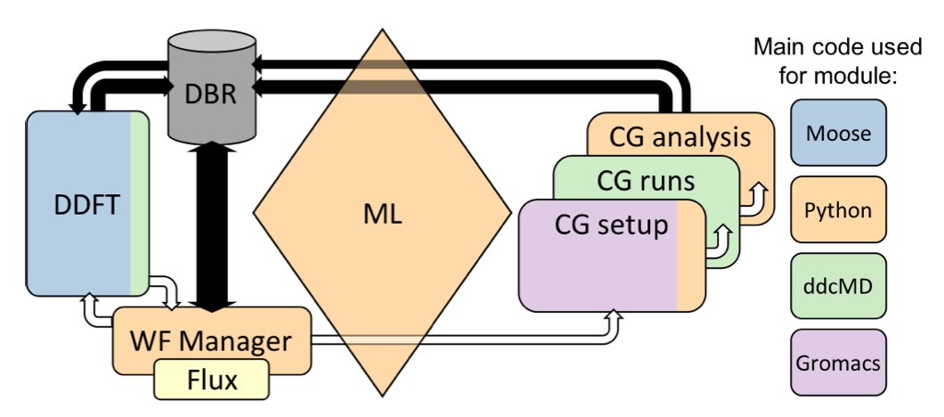
Scheduler specialization addresses co-scheduling challenges in Cancer Moonshot Pilot2 on Sierra
The machine-learning module evaluates the top n candidate patches for MD simulations.
Integrate Flux into Maestro workflow manager to start and stop jobs accordingly
Maestro adapter to Flux
Specialize the policy to be non-node-exclusive scheduling for complex co-scheduling
At least 5 different logically separate jobs, each with CPU and/or GPU requirements on every node
Handle the volume of jobs using simple hierarchical scheduling
Pilot2 workflow architecture
Franc Di Natale will present this SC19 best paper award winning work at 9:30AM today

Slide 13
Co-design with Flux is uniquely improving LLNL’s UQ Pipeline tool in 3 unprecedented ways
Enable UQP to perform quick exploratory experiments and to generate a large ensemble from it.
Improve usability and performance.
Simplify the software architecture.
Reduce software complexity and increase portability.
Position the ensemble manager for extremely high throughput workflows.
Increase scalability and exascale readiness.
We will present more details
at 1:30PM today

Slide 14
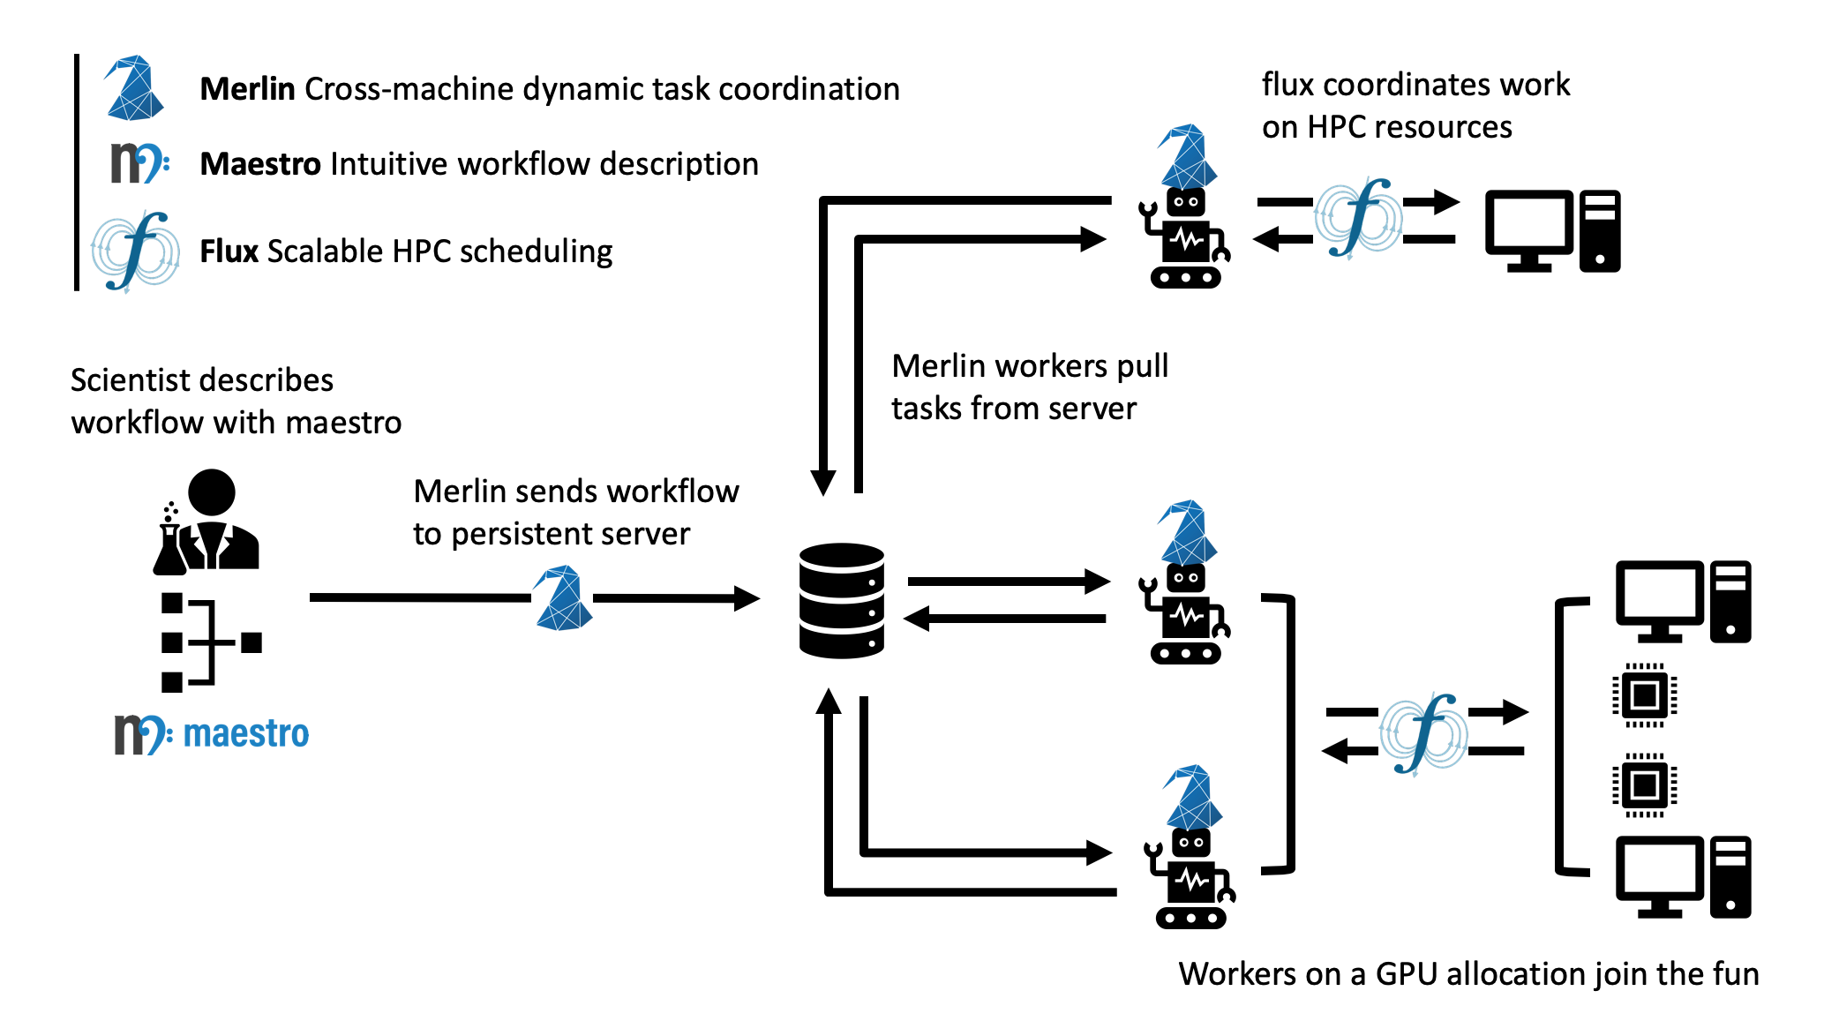
MSLI team successfully ran 100Million short-running jobs thanks to Flux.

Slide 15
The changes in resource types are equally challenging.
Problems are not just confined to the workload/workflow challenge.
Resource types and their relationships are also becoming increasingly complex.
Much beyond compute nodes and cores...
GPGPUs
Burst buffers
I/O and network bandwidth
Network locality
Power
Will be worse for exascale computing.
PFS BW Capacity

Slide 16
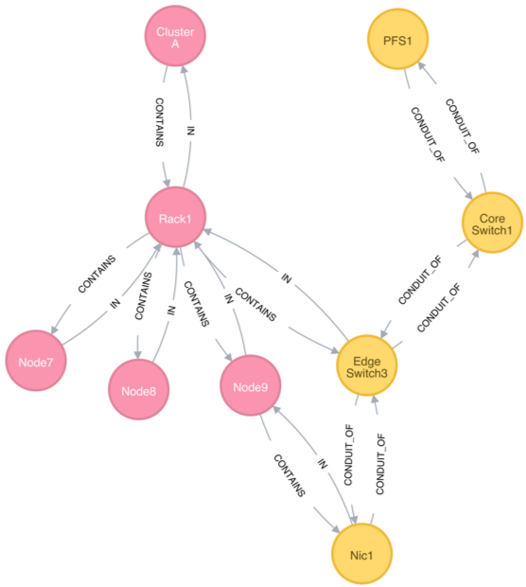
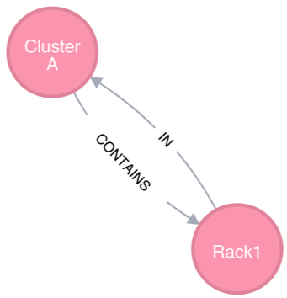
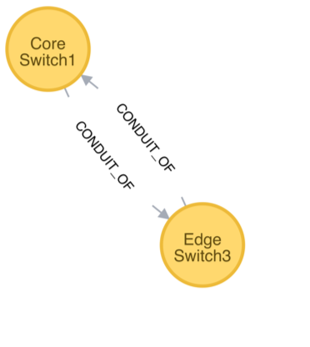
Flux uses a graph-based resource data model to represent schedulable resources and their relationships.
A graph consists of a set of vertices and edges
Vertex: a resource
Edge: a relationship between two resources
Highly composable to support a graph with arbitrary complexity
The scheduler remains to be a highly generic graph code.
Containment subsystem
We will present the graph-based resource modeling work at 3:30PM today
Network connectivity subsystem

Slide 17
Flux Plan
Flux Tutorial at ECP Annual Meeting, Feb 6, 2020
Dong H. Ahn

Slide 18
High-Level Update
Two main drivers for last and this fiscal year
Deploy Flux natively on a moderate-size TOSS4 system
Demonstrate key exascale-computing capabilities in preparation for CORAL2 El Capitan
ExaWorks: new ECP proposal

Slide 19
Recent highlights: we completed the planned development of our new execution system
Goal is to implement our execution system that meets the requirements imposed by multi-user Flux and security while making its feature set on-par with our old system called wreck.
We have been more or less on track:
Preliminary job shell (7/5/2019)
MPI Hello world (7/31/2019)
Shell plugin (08/16/2019)
Flux run prototype in review (8/16/2019)
I/O improvements (08/30/2019)
Task exit handling (09/13/2019)
Flux simulator prototype in review (11/26/2019)
Some of our workflow customers are kicking the tires

Slide 20
Recent highlights: we completed the planned integration of our graph-based scheduler
Goal is to make the feature set of our graph-based scheduler on-par with the old ad hoc system and integrate it with the new execution system
We have been more or less on track:
Introduced qmanager to tie the new job-manager with the graph scheduler (level 0 integration) (7/10/2019)
Added HPC queuing policies (EASY/HYBRID/CONSERVATIVE) (7/26/2019)
Added satisfiability checks (8/8/2019)
Added performance variation-aware scheduling support (9/30/2019)
Added JGF reader for resiliency and Kubernetes (9/9/2019)
Resource graph update using JGF for resiliency (10/4 and 12/2/2019)
New staff training and prototype for Banking and accounting (12/31/2019)
Some of our workflow customers are kicking the tires

Slide 21
Recent highlights: we completed a relatively low-cost design exploration
System instance
Identified the need for a relatively low-cost design exploration
Added remote jobshell (a.k.a., brokerless compute nodes) prototype (12/12/2019)
Determined that this does not meet an important requirement (coordinated migration of the system instance)
In the process of penciling in a more detailed design (with brokers on compute nodes)
Added a few additional weeks to our schedule
Multiuser capability
Added AddressSanitizer support to prepare for multi-user job launch
Will help write correct privileged code next quarter

Slide 22
Recent highlights: completed lots of some of less-appreciated efforts (harden, refactor and cleanup)
People often underestimate the level of effort required to harden, refactor and cleanup code for production-quality software
http://flux-framework.org/news

Slide 23
Plan for Next Two Quarters on Production Features
Goal is to produce a minimum viable Flux natively on one reasonably sizable TOSS4 Linux system
Closely coordinating this with Trent D’Hooge
Including what system we will first run Flux natively and
What features we prioritize
Plan to formalize regular Flux + sys-admin interlocks
Flux-core
Resiliency with brokers on compute nodes
KVS checkpoint and restart
Multiuser job launch
Optimization and further gap filling
Flux-sched
Complete scheduler resiliency
Banking and accounting module implementation and full evaluation
Performance and memory optimization
Hardening and further gap filling of the scheduler

Slide 24
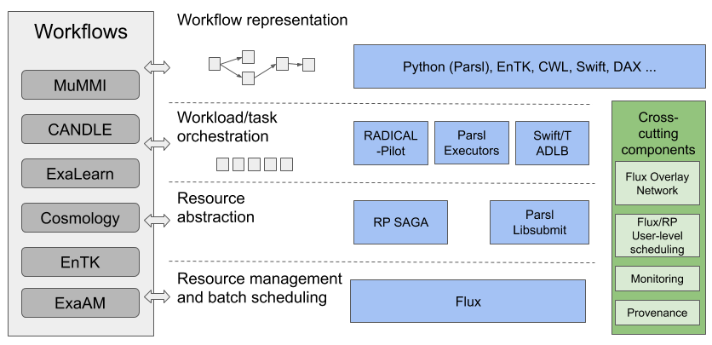
ExaWorks: a new component-based workflow toolbox R&D project proposed to ECP
Figure 1: ExaWorks workflow components showing the four component layers (workflow representation, workload orchestration, resource abstraction, and resource management) and several cross-cutting components.

Slide 25
Disclaimer
This document was prepared as an account of work sponsored by an agency of the United States government. Neither the United States government nor Lawrence Livermore National Security, LLC, nor any of their employees makes any warranty, expressed or implied, or assumes any legal liability or responsibility for the accuracy, completeness, or usefulness of any information, apparatus, product, or process disclosed, or represents that its use would not infringe privately owned rights. Reference herein to any specific commercial product, process, or service by trade name, trademark, manufacturer, or otherwise does not necessarily constitute or imply its endorsement, recommendation, or favoring by the United States government or Lawrence Livermore National Security, LLC. The views and opinions of authors expressed herein do not necessarily state or reflect those of the United States government or Lawrence Livermore National Security, LLC, and shall not be used for advertising or product endorsement purposes.

Slide 26
Flux APIs for Scientific Workflows
Anthony Agelastos, Dong H. Ahn, Frank Di Natale, Stephen Herbein, Dan Milroy, Tapasya Patki
November 8, 2019

Slide 27
What is Flux?
New Resource and Job Management Software (RJMS) developed at LLNL
A way to manage remote resources and execute tasks on them

Slide 28


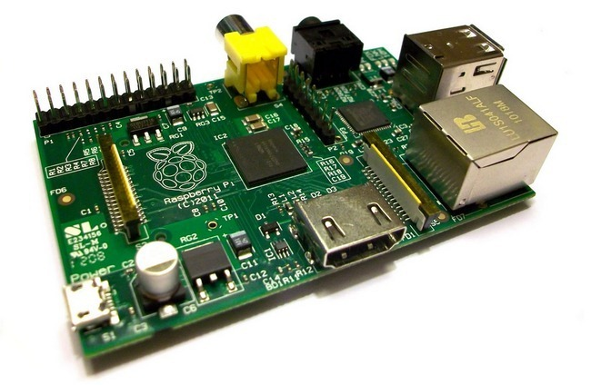

What is Flux?
New Resource and Job Management Software (RJMS) developed at LLNL
A way to manage remote resources and execute tasks on them
flickr: dannychamoro

Slide 29





What is Flux?
New Resource and Job Management Software (RJMS) developed at LLNL
A way to manage remote resources and execute tasks on them

Slide 30
Why Flux?
Extensibility
Open source
Modular design with support for user plugins
Scalability
Designed from the ground up for exascale and beyond
Already tested at 1000s of nodes & millions of jobs
Usability
C, Lua, and Python bindings that expose 100% of Flux’s functionality
Can be used as a single-user tool or a system scheduler
Portability
Optimized for HPC and runs in Cloud and Grid settings too
Runs on any set of Linux machines: only requires a list of IP addresses or PMI

Slide 31
Portability: Running Flux
Already installed on TOSS systems (including Sierra)
spack install flux-sched for everywhere else
Flux can run anywhere that MPI can run, (via PMI – Process Management Interface)
Inside a resource allocation from: itself (hierarchical Flux), Slurm, Moab, PBS, LSF, etc
flux start OR srun flux start OR flux bootstrap
Flux can run anywhere that supports TCP and you have the IP addresses
FLUX_CONF_DIR=/etc/flux flux broker -Sboot.method=config
/etc/flux/conf.d/boot.toml:
[bootstrap]
default_port = 8050
default_bind = "tcp://en0:%p”
default_connect = "tcp://e%h:%p”
hosts = [ { host="fluke0" }, { host = "fluke1" }, { host = "fluke2" } ]

Slide 32
Why Flux?
Extensibility
Open source
Modular design with support for user plugins
Scalability
Designed from the ground up for exascale and beyond
Already tested at 1000s of nodes & millions of jobs
Usability
C, Lua, and Python bindings that expose 100% of Flux’s functionality
Can be used as a single-user tool or a system scheduler
Portability
Optimized for HPC and runs in Cloud and Grid settings too
Runs on any set of Linux machines: only requires a list of IP addresses or PMI

Slide 33
Usability: Submitting a Batch Job
Slurm
sbatch –N2 –n4 –t 2:00 sleep 120
Flux CLI
flux mini submit –N2 –n4 –t 2m sleep 120
Flux API:
import json, flux, job
from flux.job import JobspecV1
f = flux.Flux()
j = JobspecV1.from_command(command=["sleep", "120"],
num_nodes=2,
num_tasks=4)
j.set_duration(120)
resp = flux.job.submit(f, j)

Slide 34
Usability: Tracking Job Status
CLI: slow, non-programmatic, inconvenient to parse
watch squeue
watch flux job list
Tracking via the filesystem
date > $JOBID.start; srun myApp; date > $JOBID.stop
Non-I/O
→ quota -vf ~/quota.conf
Disk quotas for herbein1:
Filesystem used quota limit files
/p/lscratchrza 760.3G n/a n/a 8.6M
I/O
Runtime Stages
I/O

Slide 35
Usability: Tracking Job Status
CLI: slow, non-programmatic, inconvenient to parse
watch squeue
watch flux job list
Tracking via the filesystem
date > $JOBID.start; srun myApp; date > $JOBID.stop
Job tracking via Flux:
# wait for next job to complete
fut = flux.job.wait(f)
# get completed job’s info
(jobid, success, errstr) =
flux.job.wait_get_status(fut)

Slide 36
Usability: Tracking Job Status
CLI: slow, non-programmatic, inconvenient to parse
watch squeue
watch flux job list
Tracking via the filesystem
date > $JOBID.start; srun myApp; date > $JOBID.stop
Job tracking via Flux:
# wait for next job to complete
fut = flux.job.wait(f)
# get completed job’s info
(jobid, success, errstr) =
flux.job.wait_get_status(fut)
Reactive, event-driven tracking via Flux:
f.event_subscribe(“job-state”)
f.msg_watcher_create(job_state_cb, “job-state” ).start()
f.reactor_run(f.get_reactor(), 0)
def job_state_cb (f, typemask, msg, arg):
for jobid, state in msg.payload[‘transitions’]:
print(“job", jobid, "changed to ", state)

Slide 37
Why Flux?
Extensibility
Open source
Modular design with support for user plugins
Scalability
Designed from the ground up for exascale and beyond
Already tested at 1000s of nodes & millions of jobs
Usability
C, Lua, and Python bindings that expose 100% of Flux’s functionality
Can be used as a single-user tool or a system scheduler
Portability
Optimized for HPC and runs in Cloud and Grid settings too
Runs on any set of Linux machines: only requires a list of IP addresses or PMI

Slide 38
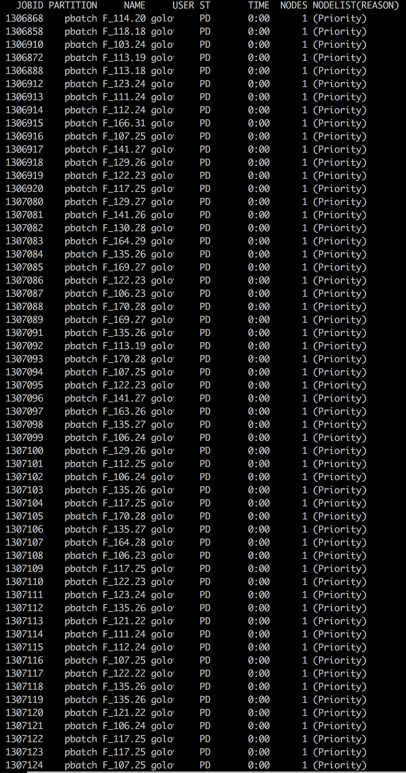
Scalability: Running Many Jobs
Slurm
find ./ -exec sbatch –N1 tar –cf {}.tgz {}\;
Slow: requires acquiring a lock in Slurm, can timeout causing failures
Inefficient: uses 1 node for each task
Subject: Good Neighbor Policy You currently have 271 jobs in the batch system on lamoab. The good neighbor policy is that users keep their maximum submitted job count at a maximum of 200 or less. Please try to restrict yourself to this limit in the future. Thank you.

Slide 39
Scalability: Running Many Jobs
Slurm
find ./ -exec sbatch –N1 tar –cf {}.tgz {}\;
Slow: requires acquiring a lock in Slurm, can timeout causing failures
Inefficient: uses 1 node for each task
find ./ -exec srun –n1 tar –cf {}.tgz {}\;
Slow: spawns a process for every submission
Inefficient: is not a true scheduler – can overlap tasks on cores

Slide 40
Scalability: Running Many Jobs
Slurm
find ./ -exec sbatch –N1 tar –cf {}.tgz {}\;
Slow: requires acquiring a lock in Slurm, can timeout causing failures
Inefficient: uses 1 node for each task
find ./ -exec srun –n1 tar –cf {}.tgz {}\;
Slow: spawns a process for every submission
Inefficient: is not a true scheduler – can overlap tasks on cores
Flux API:
flux start my_jobs.py
-----------------------------
import flux, flux.job
from flux.job import JobspecV1
h = flux.Flux()
for f in os.listdir(‘.’):
command = [“tar”, “-cf”, ”{}.tgz”.format(f), f]
flux.job.submit(h, JobspecV1.from_command(command))

Slide 41
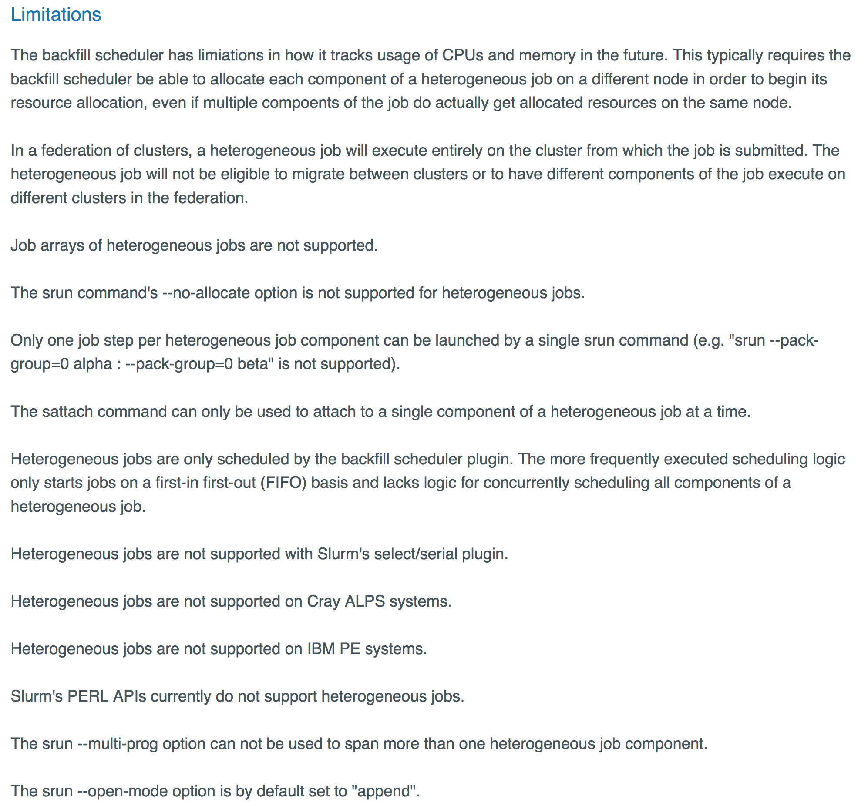
Scalability: Running Many Heterogeneous Jobs
Slurm
No support for heterogeneous job steps in versions before 17.11
Limited support in versions after 17.11
https://slurm.schedmd.com/heterogeneous_jobs.html#limitations

Slide 42
Scalability: Running Many Heterogeneous Jobs
Slurm
No support for heterogeneous job steps in versions before 17.11
Limited support in versions after 17.11
Flux API
flux start my_jobs.py
-----------------------------
import flux, flux.job
from flux.job import JobspecV1
h = flux.Flux()
for f in os.listdir(‘.’):
command = [“tar”, “-I”, “pigz”, “-cf”, ”{}.tgz”.format(f), f]
ncores = os.path.getsize(f) / 1024**3
flux.job.submit(h, JobspecV1.from_command(command, cores_per_task=ncores))

Slide 43
Scalability: Running Millions of Jobs
Single Flux Instance
flux start my_workflow.py
Statically Partitioned Flux Instances
for x in $(seq 1 $num_nodes); do flux submit -N1 flux start \ my_workflow_$x.py done
Flux Hierarchy
flux-tree –N $num_nodes \
–T ${num_nodes} \
-J $num_jobs -- jobspec.yaml
flux-tree –N $num_nodes \
–T ${num_nodes}x${cores_per_node} \
-J $num_jobs -- jobspec.yaml

Slide 44
Why Flux?
Extensibility
Open source
Modular design with support for user plugins
Scalability
Designed from the ground up for exascale and beyond
Already tested at 1000s of nodes & millions of jobs
Usability
C, Lua, and Python bindings that expose 100% of Flux’s functionality
Can be used as a single-user tool or a system scheduler
Portability
Optimized for HPC and runs in Cloud and Grid settings too
Runs on any set of Linux machines: only requires a list of IP addresses or PMI

Slide 45

Extensibility: Modular Design
At the core of Flux is an overlay network
Built on top of ZeroMQ
Supports RPCs, Pub/Sub, Push/Pull, etc
Modules provide extended functionality (i.e., services)
User-built modules are loadable too
Some modules also support plugins
External tools and commands can access services
User authentication and roles supported
Flux Instance
Service Modules
Heartbeat
Key-Value Store
Overlay Networks & Routing
Resource
Remote Execution
Msg Idioms (RPC/Pub-Sub)
Sched Framework
Comms Message Broker
Policy
Plugin A
Commands
flux submit
flux-capacitor

Slide 46
Extensibility: Creating Your Own Module
Register a new service “pymod.new_job” that ingests jobs and responds with a Job ID
Load using flux module load pymod --module=path/to/file.py
import itertools, json, flux
def handle_new_job(f, typemask, message, arg):
job_queue, job_ids = arg
job_queue.append(message.payload)
response = {‘jobid’ : job_ids.next()}
f.respond(message, 0, response)
def mod_main(f, *argv):
f.msg_watcher_create(handle_new_job, topic="pymod.new_job", args=([], itertools.count(0))).start()
f.reactor_run(f.get_reactor(), 0)

Slide 47
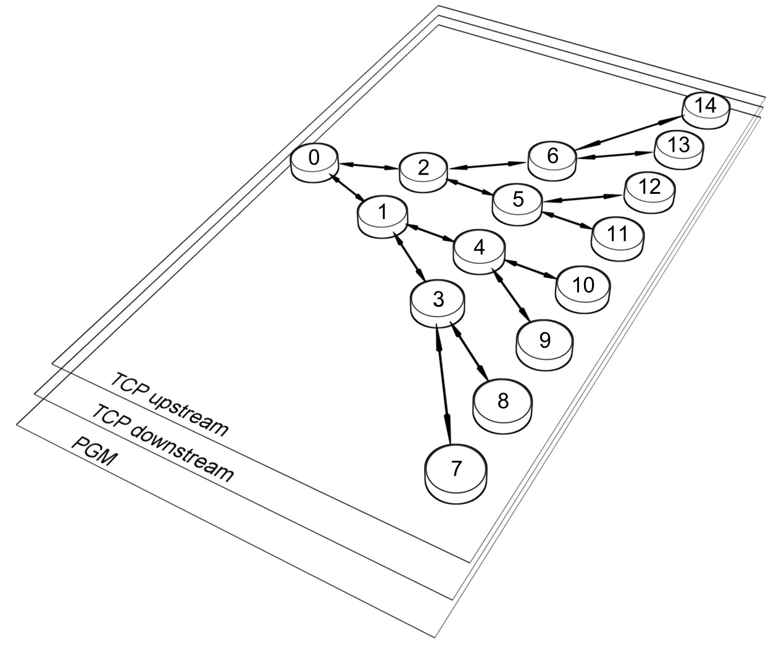
Extensibility: Flux’s Communication Overlay
Connect to a running flux instance
f = flux.Flux()
Send an RPC to a service and receive a response
resp = f.rpc(”pymod.new_job", payload) jobid =resp.get()[‘jobid’]
Subscribe to and publish an event
f.event_subscribe(“node_down”) f.msg_watcher_create(node_down_cb, topic=“node_down”).start()
f.event_send(“node_down”)

Slide 48

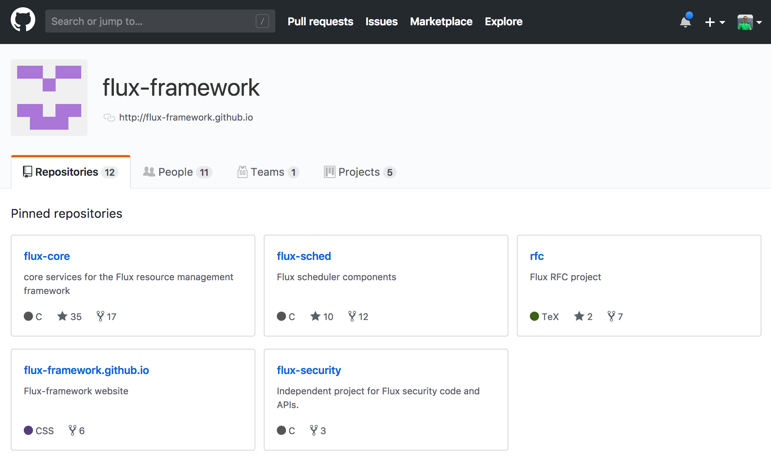
Extensibility: Open Source
Flux-Framework code is available on GitHub
Most project discussions happen in GitHub issues
PRs and collaboration welcome!
Thank You!

Slide 49
Disclaimer
This document was prepared as an account of work sponsored by an agency of the United States government. Neither the United States government nor Lawrence Livermore National Security, LLC, nor any of their employees makes any warranty, expressed or implied, or assumes any legal liability or responsibility for the accuracy, completeness, or usefulness of any information, apparatus, product, or process disclosed, or represents that its use would not infringe privately owned rights. Reference herein to any specific commercial product, process, or service by trade name, trademark, manufacturer, or otherwise does not necessarily constitute or imply its endorsement, recommendation, or favoring by the United States government or Lawrence Livermore National Security, LLC. The views and opinions of authors expressed herein do not necessarily state or reflect those of the United States government or Lawrence Livermore National Security, LLC, and shall not be used for advertising or product endorsement purposes.

Slide 50
A Massively Parallel Infrastructure for Adaptive Multiscale Simulations: Modeling RAS Initiation Pathway for Cancer
ECP Annual Meeting 2020
February 6, 2020
Francesco Di Natale
Computer Scientist
JDACS4C Pilot 2

Slide 51
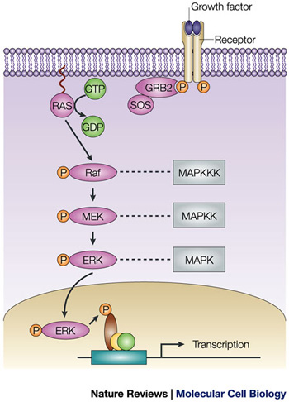
Resolving RAS dynamics is paramount to understanding cancer
Mutated RAS protein is involved in 30% of all human cancers
95% of pancreatic; 45% of colorectal; 35% of lung;
RAS sits on the cell membrane and acts as an “on switch” for cell growth
Until recently there were no known inhibitors and RAS is often considered undruggable
Activation and aggregation are dependent on the local membrane
Multiscale simulations are required to understand membrane dynamics and RAS-membrane interactions
micro: molecular level detail of the biological processes
macro: experimentally relevant length- and time-scales

Slide 52
MuMMI implements a complex workflow to enable a new genre of multiscale simulation for cancer research
Multiscale Machine-Learned Modeling Infrastructure (MuMMI)
Novel framework coupling multiple scales using a hypothesis driven selection process.

Slide 53
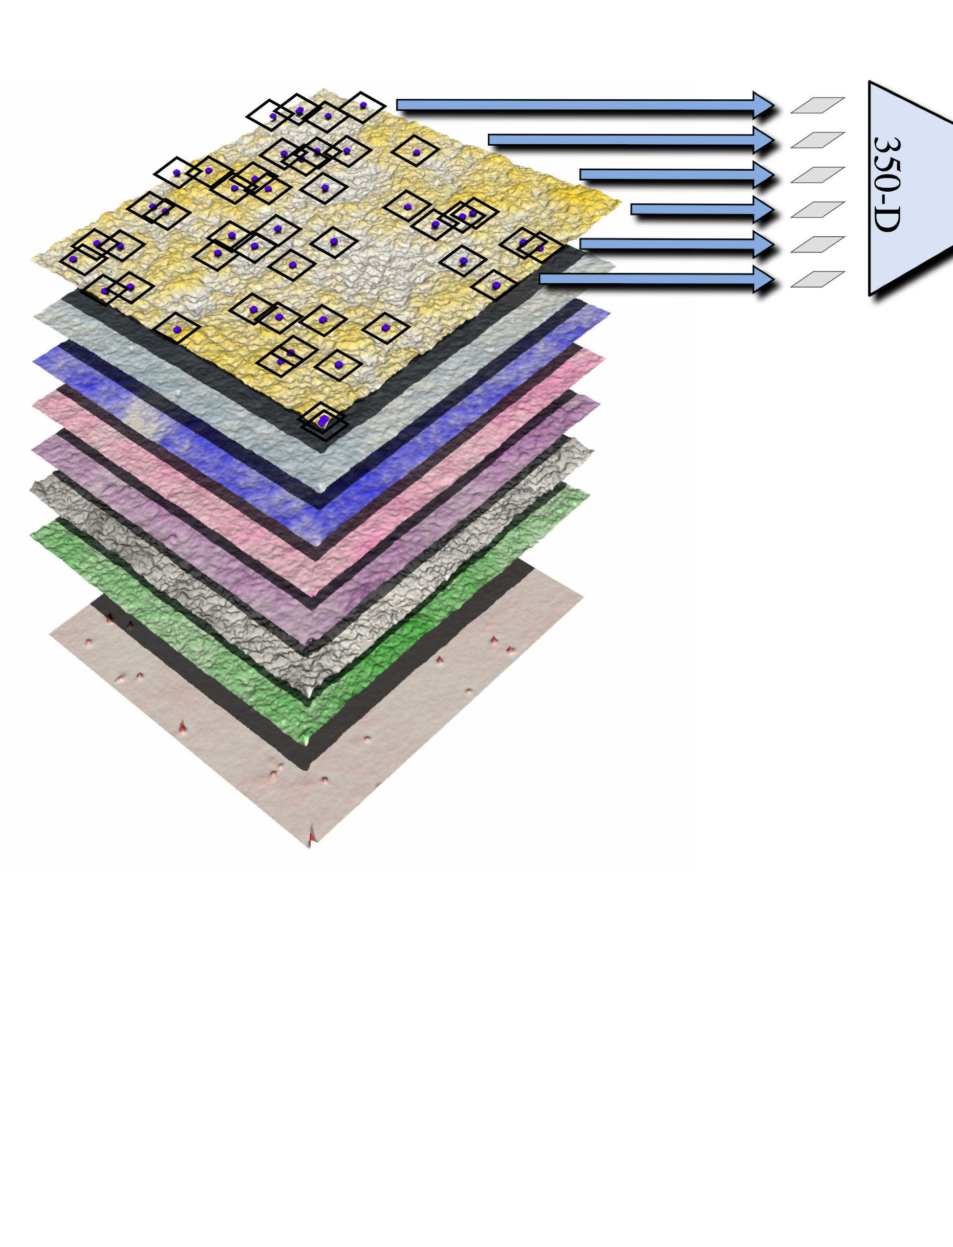

MuMMI implements a complex and dynamic workflow
CG Setup
Python; Custom; GROMACS
24 CPU cores each
1.5 hr each
…
ML-based Selection
Python; ML frameworks; FAISS
24 CPU cores >1000 decisions per minute
FIFO; real-time tracking & update
…
Single Macro Simulation
C++ (with MPI); MOOSE; ddcMD
24 CPU cores/node; 2400 MPI tasks
242 GB per day
Analysis Aggreg. & Feedback
Python; Custom
24 CPU cores 120,000 reads per cycle
CG Simulation
C++ (with CUDA); ddcMD
1 GPU + 1 CPU core each 1.04 μs and ~6.5 GB per day
In situ CG Analysis
Python; Custom
3 CPU cores each >2K frames per day

Slide 54
The workflow is responsible for managing various components in real time
…
FIFO; real-time tracking & update
…
GPFS
1400 accesses per minute
In-memory communication
File system-based communication

Slide 55
The MuMMI workflow is built on a diverse set of independent tools and software

Slide 56
The overall workflow combines three high-level components to enable efficient execution at scale
Custom in-memory workflow manager
highly configurable
on-the-fly task orchestration
coordinated checkpoint and fault recovery
A new scheduling engine extending Flux [Dong et. al]
hierarchical scheduling of all available resources
co-location across heterogenous hardware components
high throughput, low latency processing of tens of thousands of jobs
Data management framework
in situ analysis
asynchronous coordination
efficient archival

Slide 57
The scheduling engine efficiently provisions heterogenous resources across all of Sierra – 172K CPUs, 16K GPUs
Existing scheduling engines proved not flexible enough
static and flat scheduling do not scale to handle the number of required jobs
schedulers typically allocate by node, therefore do not support dynamic workflows
high turn around time especially at high job counts
We utilize Flux to provide
low-latency scheduling of thousands of jobs
hierarchical scheduling within large user-space allocation
explicit task pinning to maximize memory bandwidth

Slide 58
The workflow submits to Flux via an abstract interface provide by the Maestro Workflow Conductor
Maestro is an open source, Python tool for running workflows on various schedulers.
You can find Maestro on GitHub: https://github.com/LLNL/maestrowf
Maestro implements an interface to Flux:
# NOTE: These libraries are compiled at runtime when an allocation
# is spun up.
self.flux = __import__("flux")
self.kvs = __import__("flux.kvs", globals(), locals(), ["kvs"])
# NOTE: Host doesn"t seem to matter for FLUX. sbatch assumes that the
# current host is where submission occurs.
self.add_batch_parameter("nodes", kwargs.pop("nodes", "1"))
self._addl_args = kwargs.get("args", [])
….

Slide 59
The workflow submits to Flux via an abstract interface provide by the Maestro Workflow Conductor
# Generate a job spec
jobspec = {
"nnodes": step.run["nodes"],
"ntasks": nodes,
"ncores": ncores,
"ngpus": ngpus,
"environ": get_environment(),
"options": {
"stdio-delay-commit": 1
},
"opts": {
"nnodes": nodes,
"ntasks": nodes,
"cores-per-task": cores_per_task,
"tasks-per-node": 1,
},
"cwd": cwd,
"walltime": walltime,
}
wrapper = step.run.get("wrapper", "")
if step.run["nodes"] > 1:
if wrapper == "":
jobspec["cmdline"] = \
["flux", "broker", path]
else:
jobspec["cmdline"] = \
["flux", "broker", wrapper, path]
else:
if wrapper == "":
jobspec["cmdline"] = [path]
else:
jobspec["cmdline"] = [wrapper, path]
if self.h is None:
self.h = self.flux.Flux()
resp = self.h.rpc_send(
"job.submit", json.dumps(jobspec))

Slide 60
Flux allows nodes to be sub-divided to handle a diverse range of tasks
Each subbroker manages a single node
MuMMI utilizes binding scripts to pin processes
CG Simulations are pinned closer to the GPUs
CG Setup are swapped out as the task finishes
Macro simulations stay pinned to their nodes
Flux allows for MuMMI to pin tasks because the user owns the nodes in an allocation
Sierra Node
Nvidia V100
Nvidia V100
Nvidia V100
Nvidia V100
Macro
- or -
CG Set.
IBM Power9
IBM Power9
CG An.
CG Sim.

Slide 61
The scheduling engine efficiently provisions heterogenous resources across all of Sierra – 172K CPUs, 16K GPUs
Macro

Slide 62
The high through-put, low latency scheduling enables fast restarts and consistent utilization of all resources
Hierarchical scheduling allows us to reach steady state in ~45 minutes (newer versions will reduce turnaround time)
Depending on the scientific hypothesis we utilize >95% of the available compute
Macro

Slide 63
A scientific campaign of unprecedented scale with simulations automatically selected by specified criteria
About 120,000 unique micro simulations in total, with ∼206 ms of simulated time.
Orders of magnitude bigger than typical large campaigns
5.6 x 10⁶ GPU hours consumed over ∼14.5 days of wall-time

Slide 64



JDACS4C Pilot 2 team: A multi-faceted problem requires a multi-disciplinary team
Ryan Berg, Harsh Bhatia, Timo Bremer, Tim Carpenter, Gautham Dharuman, Francesco Di Natale, Jim Glosli, Helgi Ingólfsson, Piyush Karande, Felice Lightstone, Shusen Liu, Corey McNeish, Adam Moody, Joseph Moon, Tomas Oppelstrup, Tom Scogland, Liam Stanton, Shiv Sundram, Michael Surh, Fred Streitz, Brian Van Essen, Xiaohua Zhang
Animesh Agarwal, Angel Garcia, Sandrasegaram Gnanakaran, Nick Hengartner, Jeevapani Hettige, Cesar Lopez, Chris Neale, Sumantra Sarkar, Tim Travers, Art Voter
Arvind Ramanathan
Debsindhu Bhowmik, Christopher Stanley
Debanjan Goswami, Gulcin Gulten, Frantz Jean-Francois, Dwight Nissley, Rebika Shrestha, Andy Stephen, Dhirendra Simanshu, Tommy Turbyville, Que Van
Bruce D'Amora, Changhoan Kim, Claudia Misale, Lars Schneidenbach, Sara Kokkila Schumacher

Slide 65
Disclaimer
This document was prepared as an account of work sponsored by an agency of the United States government. Neither the United States government nor Lawrence Livermore National Security, LLC, nor any of their employees makes any warranty, expressed or implied, or assumes any legal liability or responsibility for the accuracy, completeness, or usefulness of any information, apparatus, product, or process disclosed, or represents that its use would not infringe privately owned rights. Reference herein to any specific commercial product, process, or service by trade name, trademark, manufacturer, or otherwise does not necessarily constitute or imply its endorsement, recommendation, or favoring by the United States government or Lawrence Livermore National Security, LLC. The views and opinions of authors expressed herein do not necessarily state or reflect those of the United States government or Lawrence Livermore National Security, LLC, and shall not be used for advertising or product endorsement purposes.

Slide 66
Flux Hands-on (Installing and Building)
Anthony Agelastos, Dong H. Ahn, Frank Di Natale, Stephen Herbein, Dan Milroy, Tapasya Patki

Slide 67
Poly Repo Summary
flux-security
Contains setuid binary & libraries for multi-user support
depends on
Resource Manager
Core services:
Key-Value Store
Job Manager
Simple Scheduler
Python Bindings
Most Front-End CLIs
flux-core
depends on
flux-sched
Graph-based Resource Database
Queue Manager with advanced scheduling policies

Slide 68
Docker Images (for users that want to give Flux a quick spin)
> docker pull fluxrm/flux-sched:latest
> docker run –ti fluxrm/flux-sched:latest bash
$ sudo /sbin/runuser -u munge /usr/sbin/munged
$ flux start
$ flux mini run hostname
4e94515812e9

Slide 69
Spack installation (for users that want a quick side-installation)
Install spack
git clone https://github.com/spack/spack.git
Setup spack
export SPACK_ROOT=/home/patki1/flux-tutorial/spack/
export PATH=$SPACK_ROOT/bin:$PATH
source $SPACK_ROOT/share/spack/setup-env.sh
Install flux-core and flux-sched
spack install flux-core@master
spack install flux-sched@master

Slide 70
Spack installation (for users that want a quick side-installation)
Install environment-modules for easy access (or lmod)
spack install environment-modules
source `spack location -i environment-modules`/Modules/init/bash*
Flux can now be loaded and unloaded as a module, spack sets correct paths
spack load flux-core@master
spack load flux-sched@master
$$ which flux
$$ /home/patki1/flux-tutorial/spack/opt/spack/linux-ubuntu18.04-x86_64/gcc-7.3.0/flux-core-master-5vtsnto3hbhllffc7g6nkht2at7r3hfp/bin/flux
spack unload flux-core@master
spack unload flux-sched@master
*Similar for tcsh or other shells

Slide 71
Installation from source (for developers)
redhat | ubuntu | version
autoconf | autoconf
automake | automake
libtool | libtool
libsodium-devel | libsodium-dev | >= 1.0.14
zeromq4-devel | libzmq3-dev | >= 4.0.4
czmq-devel | libczmq-dev | >= 3.0.1
jansson-devel | libjansson-dev | >= 2.6
lz4-devel | liblz4-dev
hwloc-devel | libhwloc-dev | >= v1.11, < 2.0
sqlite-devel | libsqlite3-dev | >= 3.0.0
yaml-cpp-devel | libyaml-cpp-dev | >= 0.5.1
lua | lua5.1 | >= 5.1, < 5.3
lua-devel | liblua5.1-dev | >= 5.1, < 5.3
lua-posix | lua-posix
python-devel | python-dev | >= 2.7
python-cffi | python-cffi | >= 1.1
python-six | python-six | >= 1.9
python-yaml | python-yaml | >= 3.10.0
python-jsonschema | python-jsonschema | >= 2.3.0
asciidoc | asciidoc
asciidoctor | asciidoctor | >= 1.5.7
aspell | aspell
valgrind | valgrind
mpich | mpich
Clone flux-core
https://github.com/flux-framework/flux-core.git
Install dependencies
If using ubuntu, the following may be needed:
sudo ln -s posix_c.so /usr/lib/x86_64-linux-gnu/lua/5.1/posix.so
./autogen.sh
./configure --prefix=<path-to>/flux-install/
make –j
make check
make install

Slide 72
Test flux-core installation
$$ flux keygen
Saving /home/herbein1/.flux/curve/client
Saving /home/herbein1/.flux/curve/client_private
Saving /home/herbein1/.flux/curve/server
Saving /home/herbein1/.flux/curve/server_private
$$ flux start --size=2
flux-start: warning: setting --bootstrap=selfpmi due to --size option
$$ flux mini run -n2 hostname
ip-172-31-23-210
ip-172-31-23-210
$ flux jobs -a
JOBID USER NAME STATE NTASKS TIME
861510041600 herbein1 hostname INACTIVE 2 0.31s
$$ flux ping --count=2 kvs
kvs.ping pad=0 seq=0 time=0.421 ms (DADF8!511D5!0!0)
kvs.ping pad=0 seq=1 time=0.458 ms (DADF8!511D5!0!0)

Slide 73
Test flux-core installation
$$ flux module list
Module Size Digest Idle S Service
job-manager 1304128 02A5E34 23 S
job-ingest 1205960 D4A524B 21 S
kvs 1558368 5F5DC5A 0 S
barrier 1124120 4E47443 23 S
aggregator 1141112 3E7DD17 19 S
job-exec 1273448 0ECD779 23 S
userdb 1122368 34E0A75 19 S
cron 1202688 E6A15D3 0 S
sched-simple 1236424 B297382 23 S sched
content-sqlite 1130168 8284A49 23 S content-backing
job-info 1302648 A490E12 8 S
connector-local 1110664 62924A9 0 R
kvs-watch 1299800 A31D222 23 S

Slide 74
Installation from source (for developers)
Clone flux-sched
https://github.com/flux-framework/flux-sched.git
Install flux-core, install dependencies
Export PKG_CONFIG_PATH
export PKG_CONFIG_PATH=<path-to>/flux-install/lib/pkgconfig:$PKG_CONFIG_PATH
./autogen.sh
./configure --prefix=<path-to>/flux-install/
make –j
make check && make install
libhwloc-dev >= 1.11.1 libboost packages == 1.53 or > 1.58
libboost-dev
libboost-system-dev
libboost-filesystem-dev
libboost-thread-dev
libboost-graph-dev
libboost-regex-dev
libxml2-dev >= 2.9.1

Slide 75
Test flux-sched installation
$$ flux keygen # if you didn't run keygen while testing flux-core
$$ flux start --size=2
$$ flux module remove sched-simple
$$ flux module load resource
$$ flux module load qmanager
$$ flux module list
Module Size Digest Idle S Service
cron 1202688 C983CCA 0 S
barrier 1124120 0D89A2E 19 S
job-info 1302648 9E06142 16 S
job-ingest 1205960 3402F27 14 S
qmanager 1088544 F13B4EA 16 S sched
job-exec 1273448 0934B49 18 S
kvs-watch 1299800 EDAA28F 16 S
aggregator 1141112 D2C34C5 18 S
userdb 1122368 57F855E 18 S
kvs 1558368 74CC3B0 0 S
resource 18210448 9CFBCFD 22 S
job-manager 1304128 C49E095 16 S
connector-local 1110664 4B13F7C 0 R
content-sqlite 1130168 BB634BE 16 S content-backing

Slide 76
Test flux-sched installation
$$ flux mini submit -n2 sleep 0
32812040192000
$$ flux job info 32812040192000 R
{"version":1,"execution":{"R_lite":[{"rank":"0","node":"quartz2300","children":{"core":"34-35"}}]}}
$$ flux job eventlog 32812040192000
1579158133.589118 submit userid=51249 priority=16 flags=0
1579158133.606256 depend
1579158133.616810 alloc note=""
1579158133.634276 start
1579158133.723823 finish status=0
1579158133.732106 release ranks="all" final=true
1579158133.733731 free
1579158133.733747 clean

Slide 78
Flux: Hands-on Workflow Examples
Anthony Agelastos, Dong H. Ahn, Frank Di Natale, Stephen Herbein, Dan Milroy, Tapasya Patki
February 2020

Slide 79
Example 1: Partitioning vs Overlapping Scheduling - CLI
Partitioning Scheduling
Overlapping Scheduling

Slide 80
Example 1: Partitioning vs Overlapping Scheduling - CLI
Partitioning Scheduling
Overlapping Scheduling
flux mini submit –N 2 –n 6 ./compute.py
flux mini submit –N 3 –n 6 ./compute.py
compute
compute
compute
compute
compute
compute
compute
compute
compute
compute
compute
compute

Slide 81
Example 1: Partitioning vs Overlapping Scheduling - CLI
Partitioning Scheduling
Overlapping Scheduling
flux mini submit –N 2 –n 6 ./compute.py
flux mini submit –N 1 –n 3 ./io-forwarding.py
flux mini submit –N 3 –n 6 ./compute.py
flux mini submit –N 3 –n 3 ./io-forwarding.py
compute
compute
IO-forwarding
compute
compute
compute
compute
compute
IO-forwarding
compute
compute
compute
compute
compute
IO-forwarding
IO-forwarding
IO-forwarding
IO-forwarding

Slide 82
Example 2: Partitioning vs Overlapping Scheduling - Python
Partitioning Scheduling
Overlapping Scheduling
flux.job.JobspecV1.from_command(
command=["./compute.py"],
num_tasks=6, num_nodes=2)
flux.job.JobspecV1.from_command(
command=["./compute.py"],
num_tasks=6, num_nodes=3)
submitter.py:
submitter2.py:
compute
compute
IO-forwarding
compute
compute
compute
compute
compute
IO-forwarding
compute
compute
compute
compute
compute
IO-forwarding
IO-forwarding
IO-forwarding
IO-forwarding

Slide 83
Example 7: Job Status & Control API
Schedule and launch jobs
compute.py
bookkeeper.py
Submit jobs
Flux
Job Queue
compute
Job State Counters
Io-forward
Subscribe to job state changes
Submitted:
Notify subscriber of jobs completing
compute
IO_forwarding.py
4
Notify subscriber of jobs starting
0
4
Io-forward
2
Completed:
0
Jobs complete
Exit Condition Reached

Slide 84
Example 10: Wait in Order
Wait_in_order.py
Submit jobs
Flux
Job Queue

Slide 85
Example 10: Wait in Order
Wait_in_order.py
Flux
Job Queue
Wait for Job 1
Valid
Valid
Invalid
Invalid

Slide 86
Example 10: Wait in Order
Schedule and launch valid jobs
Valid
Wait_in_order.py
Flux
Job Queue
Wait for Job 1
Valid
Reject Invalid Jobs
Invalid
Invalid

Slide 87
Example 10: Wait in Order
Wait_in_order.py
Flux
Job Queue
Wait for Job 1
Valid
Signal completion of Job 1
Job 1 completes
Reject Invalid Jobs
Invalid
Invalid

Slide 88
Example 10: Wait in Order
Wait_in_order.py
Flux
Job Queue
Wait for Job 2
Job 2 completes
Reject Invalid Jobs
Invalid
Invalid

Slide 89
Example 10: Wait in Order
Wait_in_order.py
Flux
Job Queue
Wait for Job 2
Signal completion of Job 2
Reject Invalid Jobs
Invalid
Invalid

Slide 90
Example 10: Wait in Order
Wait_in_order.py
Flux
Job Queue
Wait for Job 3
Signal rejection of Job 3
Reject Invalid Jobs
Invalid

Slide 91
Example 10: Wait in Order
Wait_in_order.py
Flux
Job Queue
Wait for Job 4
Signal rejection of Job 4
Reject Invalid Jobs

Slide 92
Example 10: Wait in Order
Wait_in_order.py
Flux
Job Queue

Slide 93
Example 10: Wait Any
Wait_any.py
Flux
Job Queue
Submit Jobs
Valid
Valid
Invalid
Invalid

Slide 94
Example 10: Wait Any
Wait_any.py
Flux
Job Queue
Wait for Next Job
Completion
Valid
Valid
Invalid
Invalid

Slide 95
Example 10: Wait Any
Schedule and launch valid jobs
Valid
Wait_any.py
Flux
Job Queue
Wait for Next Job
Completion
Valid
Reject Invalid Jobs
Invalid
Invalid

Slide 96
Example 10: Wait Any
Valid
Wait_any.py
Flux
Job Queue
Wait for Next Job
Completion
Valid
Signal rejection of Job 3
Reject Invalid Jobs
Invalid

Slide 97
Example 10: Wait Any
Valid
Wait_any.py
Flux
Job Queue
Wait for Next Job
Completion
Valid
Signal rejection of Job 4
Reject Invalid Jobs

Slide 98
Example 10: Wait Any
Wait_any.py
Flux
Job Queue
Wait for Next Job
Completion
Valid
Signal completion of Job 1
Job 1 completes

Slide 99
Example 10: Wait Any
Wait_any.py
Flux
Job Queue
Wait for Next Job
Completion
Signal completion of Job 2
Job 2 completes

Slide 100
Example 10: Sliding Window
Sliding_window.py
Flux
Job Queue

Slide 101
Example 10: Sliding Window
Sliding_window.py
Flux
Job Queue
Submit N Jobs
Valid
Valid
Valid

Slide 102
Example 10: Sliding Window
Schedule and launch jobs
Valid
Sliding_window.py
Flux
Job Queue
Wait for Next Job Completion
Valid
Valid

Slide 103
Example 10: Sliding Window
Schedule and launch next job
Valid
Sliding_window.py
Flux
Job Queue
Wait for Next Job Completion
Valid
Signal completion of Job 1
Job 1 completes

Slide 104
Example 10: Sliding Window
Valid
Sliding_window.py
Flux
Job Queue
Submit Next Job
Valid
Valid

Slide 105
Example 10: Sliding Window
Valid
Sliding_window.py
Flux
Job Queue
Wait for Next Job Completion
Valid
Valid

Slide 106
Disclaimer
This document was prepared as an account of work sponsored by an agency of the United States government. Neither the United States government nor Lawrence Livermore National Security, LLC, nor any of their employees makes any warranty, expressed or implied, or assumes any legal liability or responsibility for the accuracy, completeness, or usefulness of any information, apparatus, product, or process disclosed, or represents that its use would not infringe privately owned rights. Reference herein to any specific commercial product, process, or service by trade name, trademark, manufacturer, or otherwise does not necessarily constitute or imply its endorsement, recommendation, or favoring by the United States government or Lawrence Livermore National Security, LLC. The views and opinions of authors expressed herein do not necessarily state or reflect those of the United States government or Lawrence Livermore National Security, LLC, and shall not be used for advertising or product endorsement purposes.

Slide 107
Manage Internal Queue w/ Flux for Common Workflows
Slides & Content Generated by
Anthony Agelastos, Gary Lawson, Dong Ahn, Mark Grondona, Stephen Herbein
Slides Presented by
LLNL Flux Team

Slide 108
Acknowledgments
This presentation would not have been possible without the following direct contributions
LLNL
Dong Ahn
Jim Garlick
Mark Grondona
Stephen Herbein
Daniel Milroy
Tapasya Patki
Francesco Di Natale
SNL
Anthony Agelastos
Gary Lawson
… with motivation/need exhibited from the following indirect contributions
SNL
Micheal Glass (ASC IC/ATDM)
Brian Adams (ASC Dakota)
Paul Wolfenbarger (ASC CompSim DevOps)
Richard Drake (ASC CompSim DevOps)
Steve Monk (FOUS)
Ann Gentile (FOUS)

Slide 109
Executive Summary
There are many workflows that require launching and processing jobs in bulk.
Testing, Uncertainty Quantification (UQ), Verification and Validation (V&V), optimization, parameter study, and Design of Experiments (DoE) are typical activities that require bulk processing.
The activities above are lumped into the following 2 categories.
Unit & Regression Testing
Development teams have tens of thousands of test cases that, ideally, would be run for every commit (many times per day) using low-to-medium scale resources.
Ensemble Processing
Analysts may need to have thousands-to-millions of fast test cases for a study using low-to-large resources.
These cases, individually, are fast but their quantity exceeds what is reasonable for submitting to traditional HPC queues which are optimized for lower numbers of longer-running jobs.

Slide 110
Executive Summary (contd.)
Purpose
This presentation provides a demonstration of using Flux to address these use cases.
Method
A simple test case was created for the demonstration.
A modern Flux installation was created (the version bundled with TOSS is stale).
Caveats, experiences, results, and methods for extending to more complicated problems are disseminated.
Discuss observed barrier to entry from someone _not_ on the development team.
The example is simple to help prospective users understand Flux’s small barrier to entry for evaluation.
Results
Flux installation was robust and easy.
Getting Flux working as an internal queue for problems is very fast and reliable.
Information supporting both activity categories is presented.

Slide 111
Installing Flux
Experiences & Notes
Instructions for “developer” and Spack builds were followed and resulted in success on the 1st try.
Intel compiler versions 16, 19 & GNU compiler versions 4.8, 8.2 were tried and all resulted in a build of Flux on TOSS.
Certain OpenMPI versions contain bugs and cause issues with Flux.
Bug: https://github.com/open-mpi/ompi/issues/6730
PR: https://github.com/open-mpi/ompi/pull/6764
Currently, avoid most versions >= 3.1.0 (issue confirmed on 3.1.0, 3.1.3, 4.0.0, 4.0.1)
Test case was performed with OpenMPI 1.10.
Test suite worked as expected and displayed passing/failing tests.
Compiling and installing Flux was easy & reliable on TOSS/RHEL.

Slide 112
Unit & Regression Test Case: Description
$ srun -N 2 -n 72 ./mpi_greet_after_sleep
Hello WORLD! I am node ama42 with 72 ranks
Started at: Mon Jan 27 22:13:55 2020
Finished at: Mon Jan 27 22:14:15 2020
mpi_greet_after_sleep is a simple MPI application that does the following:
MPI_Barrier() (syncs ranks after initialization)
sleep(20) (sleeps for 20 sec.)
get_time_of_day() (gets current date & time)
MPI_Barrier() (syncs ranks)
rank 0 process spits out location and timing info
Simple application is used to create example test case

Slide 113
Unit & Regression Test Case: Using with Flux CLI
Get an allocation on 4 nodes
salloc –N 4 --time=4:00:00
Tell Flux you want backfill
export FLUX_QMANAGER_OPTIONS="queue-policy=easy"
Start Flux upon the 4 nodes with 1 Flux instance per node
srun --pty --mpi=none -N 4 -n 4 flux start -o,-S,log-filename=mpi_greet_after_sleep.log
Submit a case
flux mini submit -N 4 -n 144 -t 30 ./mpi_greet_after_sleep >>submit_id 2>&1
Get job output if desired
flux job attach `cat submit_id`
This is a high-level overview of the entire process! There are not many steps!

Slide 114
Unit & Regression Test Case: Workload
The workload contains the following 41 jobs:
1x 4-node job
2x 3-node jobs
4x 2-node jobs
10x 1-node jobs
8x ½-node jobs
16x ¼-node jobs
The workload was designed to take ≅3:00 if the entire 4-node allocation was wholly utilized.
4-node
3-node
1-node
3-node
1-node
2-node
2-node
2-node
2-node
1-node
1-node
1-node
1-node
1-node
1-node
1-node
1-node
½
½
½
½
½
½
½
½
¼
¼
¼
¼
¼
¼
¼
¼
¼
¼
¼
¼
¼
¼
¼
¼
Workload contains jobs that only require a fraction of a node’s resources up to 4 nodes.

Slide 115
Unit & Regression Test Case: Ordered Submission
Submission Order (# nodes)
Node 1
Node 2
Node 3
Node 4
4
3
3
2
2
2
2
1
1
1
1
1
1
1
1
1
1
½
½
½
½
½
½
½
½
¼
¼
¼
¼
¼
¼
¼
¼
¼
¼
¼
¼
¼
¼
¼
¼
Wave 1
4-node
2
1-node
3-node
3
1-node
3-node
4
1-node
2-node
5
2-node
2-node
6
2-node
1-node
1-node
7
1-node
1-node
1-node
1-node
8
½
½
1-node
½
½
½
½
9
½
¼
¼
¼
¼
½
¼
¼
¼
¼
¼
¼
¼
¼
10
¼
¼
¼
¼
The packing was nearly optimal; runtime variations and inconsistent start times are cause for extra wave.

Slide 116
Unit & Regression Test Case: Random Submission
Submission Order (# nodes)
Node 1
Node 2
Node 3
Node 4
¼
1
¼
¼
¼
3
¼
1
¼
¼
1
1
1
¼
½
¼
1
½
1
¼
½
½
2
¼
½
1
4
¼
¼
¼
2
½
½
¼
2
¼
1
3
1
½
2
Wave 1
¼
¼
¼
¼
1-node
2
¼
¼
¼
¼
3-node
3
1-node
1-node
1-node
1-node
4
½
¼
¼
1-node
½
½
1-node
5
½
¼
¼
½
¼
¼
2-node
6
1-node
7
4-node
8
½
½
2-node
¼
¼
½
9
1-node
2-node
10
3-node
1-node
11
2-node
Packing was less optimal due to queue depth optimization + job start/stop not synced.

Slide 117
Unit & Regression Test Case: Random Submission (contd.)
Extra Specialization
Can specify queue depth optimization parameter via: FLUX_QMANAGER_OPTIONS="queue-policy=easy queue-params=queue-depth=<#>"
Queue depth = 2 had 12 waves
Queue depth = 20 had 11 waves
Queue depth = 41 had 10 waves
Queue depth = 100 had 10 waves
More detailed discussion regarding this at https://github.com/flux-framework/flux-sched/issues/572
Simple tuning of the queue depth reduced the amount of waves down to 10.

Slide 118
Enhancing the Test Case: Submitting Scripts
OLD: Submit a case (directly calling application mpi_greet_after_sleep)
flux mini submit -N 4 -n 144 -t 30 ./mpi_greet_after_sleep
NEW: Submit a case (calling script internal_script.sh)
flux mini submit -N 4 -n 4 flux start ./internal_script.sh
NEW: Within script (internal_script.sh) execute parallel application with this
flux mini run -N 4 -n 144 -t 30 ./mpi_greet_after_sleep
Scripts can be run as well and each script can run different sized applications that Flux will manage.

Slide 119
Limitations with Large Ensemble Processing
Flux Interface
Flux supports a command line interface (which was leveraged for the technology demonstration herein).
Flux also provides a Python API and other methods for ingesting jobs.
Python API is the preferred method for interacting with Flux for medium-to-complicated workflows.
Issue with Submitting Large Ensembles
Methods described herein have a “slow” ingest rate of 4-8 job/s. This would require almost 2 days for 1 million jobs, which may not work for such a large ensemble. ☹
Thankfully, they have bulk loaders and methods directly accessible with their Python API to drastically increase this to over 600 job/s (needing about 30 minutes to submit a full stack of 1 million jobs). ☺
Refer to discussions within https://github.com/flux-framework/flux-sched/issues/573 for more details.
Flux has a diverse set of accessor methods that can tailor to many workflows.

Slide 120
Conclusions & Future Work
Conclusions
Flux was easy to install, run, and extend to suit the simple example herein.
Flux is very easy to use for managing internal queues and provides good behaviors right out of the box with minimal tinkering.
Flux is the most comprehensive solution tested to date for dynamic workflows consisting of heterogeneous jobs.
Future Work
SNL Dakota team is crafting a dynamic, heterogeneous optimization case that involves real simulation codes being driven by Dakota. Flux will be put in the loop to manage the resource allocations as a more expanded example case to share with the broader Dakota user base.
Data herein will be disseminated to various teams whose testing strategies can be enhanced with Flux.

Slide 121
Using Flux to Improve the Usability, Performance, and Software Complexity of UQ Pipeline
Flux Tutorial at ECP Annual Meeting, Feb 6, 2020
Dong H. Ahn, Stephen Herbein, James Corbett, and David M. Domyancic

Slide 122
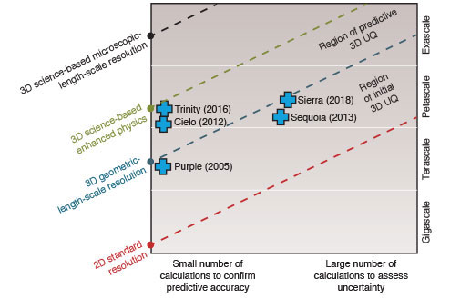
Uncertainty Quantification (UQ) workflows are critically important for the DOE.
UQ is the quantitative characterization and reduction of uncertainty in simulation applications
UQ studies to understand our simulation codes.
Evaluate input parameter impacts on outcomes.
Assess likelihood of certain outcomes.
Make predictions about untested experiments with uncertainty based on relevant previously completed experiments
https://wci.llnl.gov/simulation/computer-codes/uncertainty-quantification

Slide 123
UQ Pipeline (UQP): LLNL’s marquee UQ workflow management system.
Account for ~50.9 million CPU hours each year at LLNL.
Used in daily for WCI and NARAC programmatic work
Composed of multiple capabilities
Sampling methods
Ensemble generation and management
Surrogate model methods
Sensitivity Analysis (quantify the influential input parameters)
UQ analysis methods
The pipeline’s sampling and ensemble generation capabilities are also used to generate simple parameter studies.
UQP Workflow Overview
UQP Configuration
Parameter selection
Initial sample point set
Simulation files
Ensemble Generation & Execution
Training data
Surrogate Model Construction
Experimental data
Sensitivity & UQ Analysis

Slide 124
The UQP ensemble manager is the enabling component for efficiently running ensembles.
UQ Pipeline Ensemble Manager
Slot 1
Slot 2
Slot N
…
Executes on the first node and subdivides remaining allocated nodes into N uniform “slots”.
Each slot executes one of M ensemble simulations using the parallel job launcher (e.g., srun).
The ensemble manager dynamically manages the slots.
The ensemble manager can restart/terminate simulations, reduce/disable slots, or terminate the entire ensemble.
Users can pass command directives back to the ensemble manager (e.g. restart, terminate, …).

Slide 125
UQP desires to improve its ensemble manager by solving three concrete problem using Flux.
An ability to perform quick exploratory experiments and to generate a large ensemble from it.
by allowing for running users' batch scripts directly
Improve usability and performance.
Simplify the software architecture.
Reduce software complexity and increase portability.
Position the ensemble manager for extremely high throughput workflows.
Increase scalability and exascale readiness.
Detail follows...

Slide 126
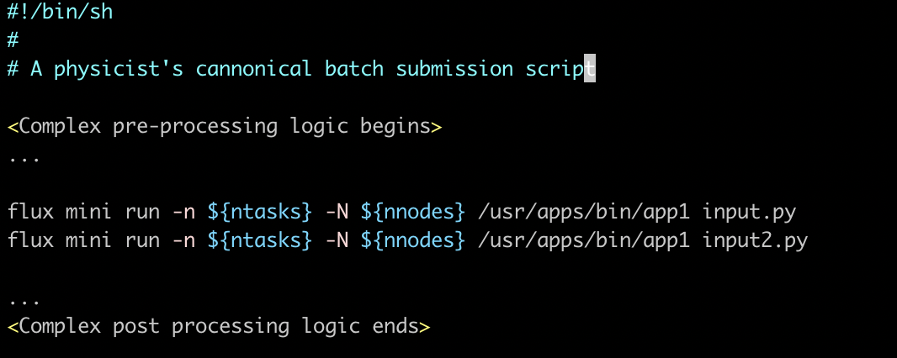
Flux uniquely enables UQP to map better to the representative workflows of UQ scientists.
Quick exploratory simulation experiments on some changes
No high-throughput support and other tool support
Previously simulated results and batch submission scripts
Simulation campaign
UQ jobs
Large ensemble
Replicate the logic in batch script
Script rewrite to UQP non-trivial
No explicit support for the next cycle

Slide 127
Flux uniquely enables UQP to map better to the representative workflows of UQ scientists.
The first step towards UQ: quick exploratory experiments
A few nominal simulations are the seed of all types of studies
parameter, sensitivity and UQ studies.
The scientist’s batch script captures the exact requirements.
Desire a large ensemble generated directly using this script.
The traditional batch-scheduling approach significantly limits UQP.
Submitting those scripts to the batch scheduler doesn’t meet the turn-around time requirement.
Running this with UQP in high throughput mode would be ideal but…
The ad-hoc scheduler building on launchers doesn’t easily support this.
Porting the script to the UQP interface is not easy on the other hand.
Flux’s fully hierarchical scheduling comprehensively solves this.

Slide 128
Our fully hierarchical scheduling model naturally maps to the representative UQ workflows.
script.sh
Slot 1
Slot 2
Slot N
UQ Pipeline Ensemble Manager using Flux
…
As simple as: % flux mini submit -N 1 -n1 flux start ./script.sh
A prototype implemented to get more user feedback

Slide 129
The software architect of the ensemble manager with the traditional batch scheduling approach.
Login Nodes
Compute Nodes
User
UQP Scheduler and Status Monitor
Starts
Interacts with
Runs
UQP API
Prep
Prep
Prep
Prep
Creates
Slurm Run
Slurm Run
LSF Run
LSF Run
Slurm Run
Slurm Run
LSF Run
LSF Run
Slurm Allocator
LSF Allocator
Finish
Finish
Finish
Finish

Slide 130
Flux significantly reduces the software complexity of UQP and improves its portability.
Login Nodes
Compute Nodes
User
A short UQP script
Flux Instance
Interacts with
Starts
Bundles and submits
UQP API
Executes
Prep
Flux Bootstrap
Flux Run
Finish

Slide 131
Flux positions UQP for extremely high-throughput workflows towards exascale computing.
Already at pre-exascale, users want to run a billion short-running jobs!
Flux Instance
Flux Instance
Flux Instance
Prep
Prep
Prep
Prep
Flux Run
Flux Run
Flux Run
Flux Run
Finish
Finish
Finish
Finish
As simple as: flux tree -N 4 –n4 –T2 -J4 ./script.sh
E.g. deeper tree by specifying the hierarchical policy (-T 2x2x2)

Slide 132
The novel scheduling model of Flux is uniquely enabling UQP.
DOE is increasingly interested in uncertainty quantification (UQ).
UQP is a highly important workflow management tool for LLNL.
Flux-UQP co-design is enabling UQP in 3 unprecedented ways.
Enable UPQ to run users’ batch scripts with no modification.
Simplify the software architecture of UQP.
Position UPQ for extremely high throughput workloads.

Slide 133
Disclaimer
This document was prepared as an account of work sponsored by an agency of the United States government. Neither the United States government nor Lawrence Livermore National Security, LLC, nor any of their employees makes any warranty, expressed or implied, or assumes any legal liability or responsibility for the accuracy, completeness, or usefulness of any information, apparatus, product, or process disclosed, or represents that its use would not infringe privately owned rights. Reference herein to any specific commercial product, process, or service by trade name, trademark, manufacturer, or otherwise does not necessarily constitute or imply its endorsement, recommendation, or favoring by the United States government or Lawrence Livermore National Security, LLC. The views and opinions of authors expressed herein do not necessarily state or reflect those of the United States government or Lawrence Livermore National Security, LLC, and shall not be used for advertising or product endorsement purposes.

Slide 134
Future Flux developments: not nebulous, but a bit cloudy
2020 ECP Annual Meeting Tutorial
Anthony Agelastos, Dong Ahn, Francesco Di Natale, Stephen Herbein, Daniel Milroy, Tapasya Patki
02/06/2020

Slide 135
Outline
Containers are becoming common in HPC
Kubernetes (k8s): container management
Challenges for converged k8s-HPC
Flux in the cloud

Slide 136
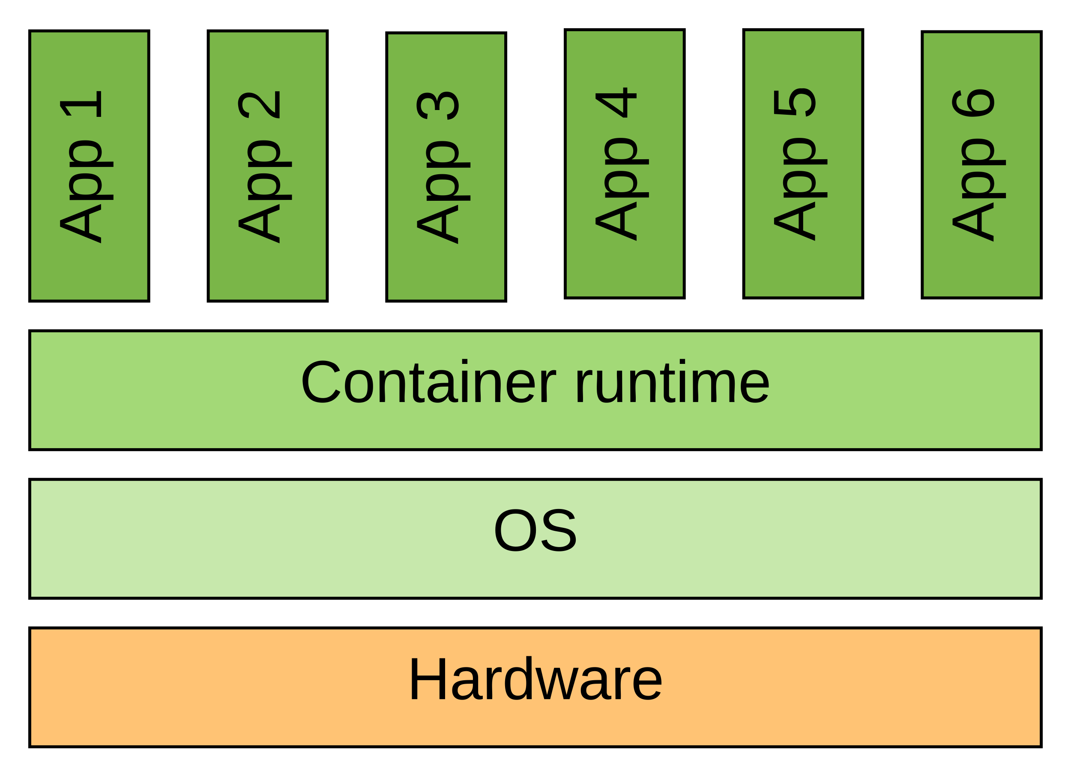
Containerized computing in widespread use
A lot of interest in containers because:
portable
packages software and dependencies
charge by use
lightweight
share OS kernel
no need for OS virtualization
low/negligible performance impact
(CANOPIE 2019, etc.)
elasticity

Slide 137
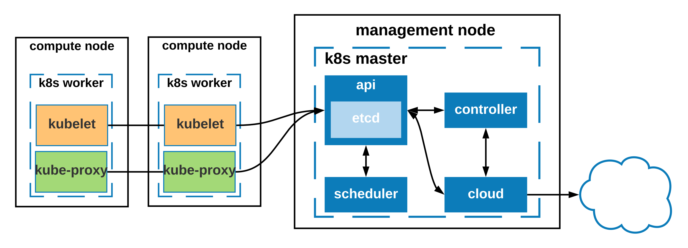
Managing containers
“Container orchestration” via Kubernetes
manage container lifecycle
manage container networking
declarative management
auto scaling
cloud integration

Slide 138
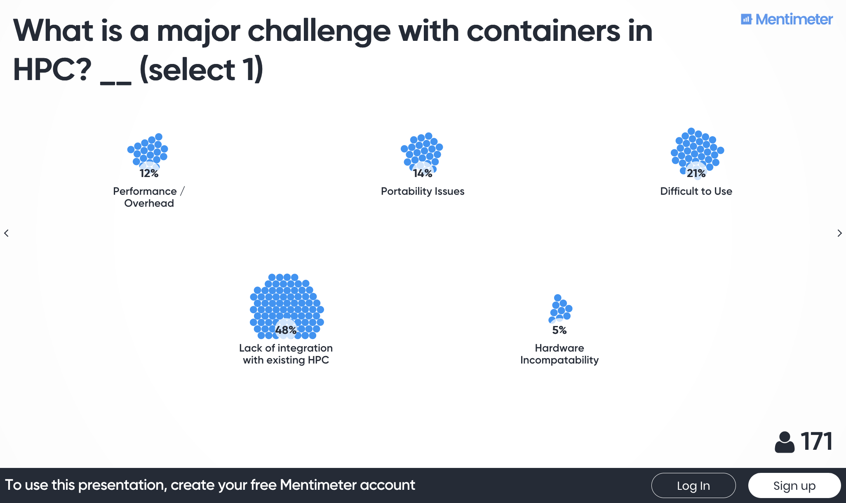
Substantial, growing interest + HPC
KubeCon + CloudNativeCon NA 2019
12,000 attendees (50% increase from 2018, 200% increase from 2017)
Containers in HPC (SC19 BoF)

Slide 139
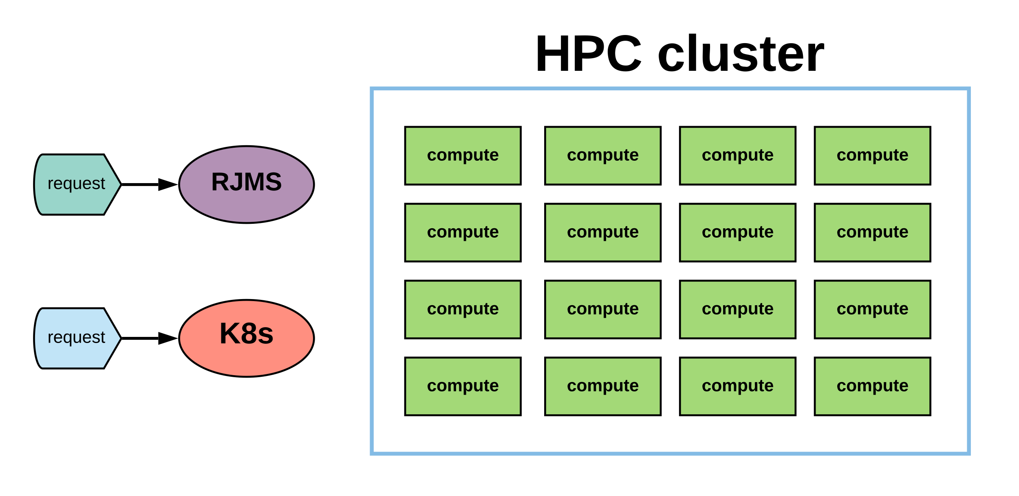
Converged k8s and HPC

Slide 140
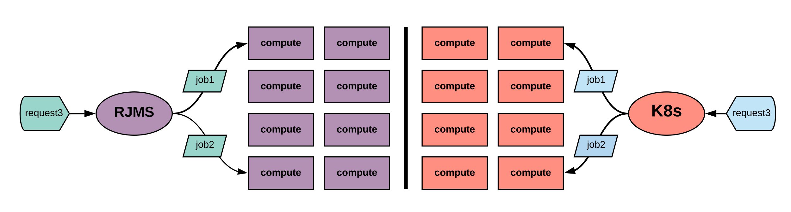
Converged k8s and HPC: static partitions

Slide 141
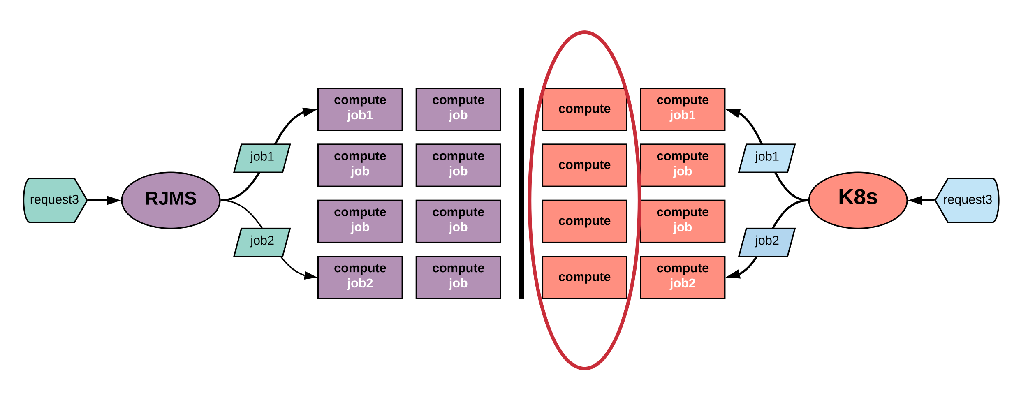
Static partitions challenge: inefficiency

Slide 142
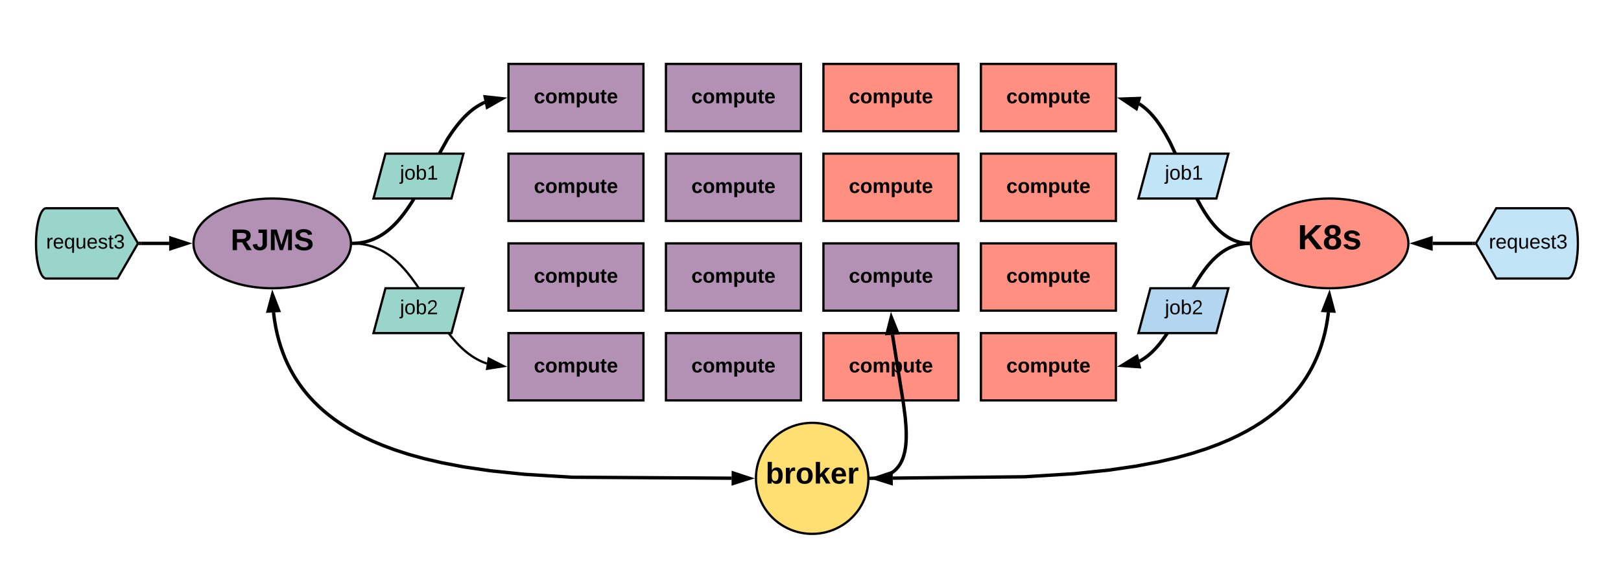
Converged k8s and HPC: resource broker

Slide 143
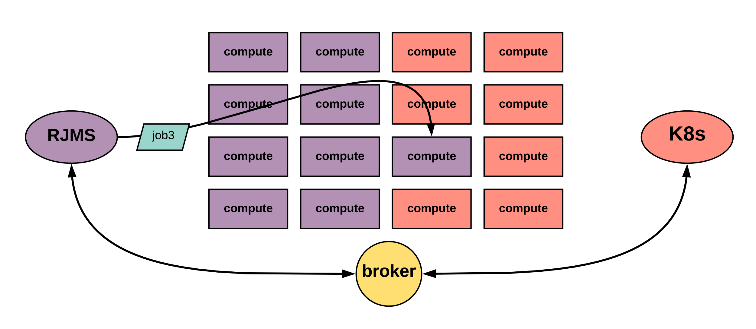
Converged k8s and HPC: resource broker

Slide 144
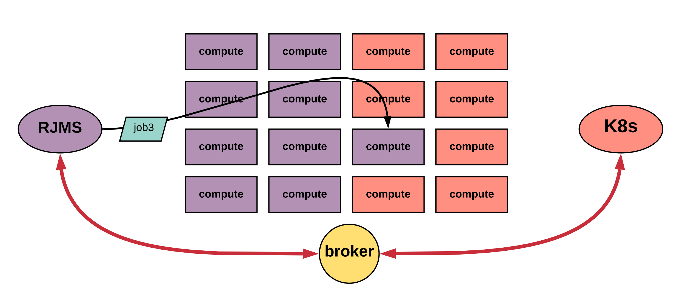
Resource broker challenge: synchronization

Slide 145
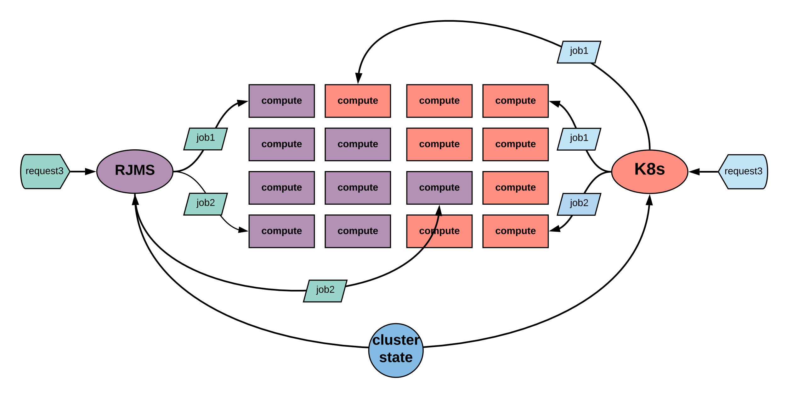
Converged k8s and HPC: shared state

Slide 146
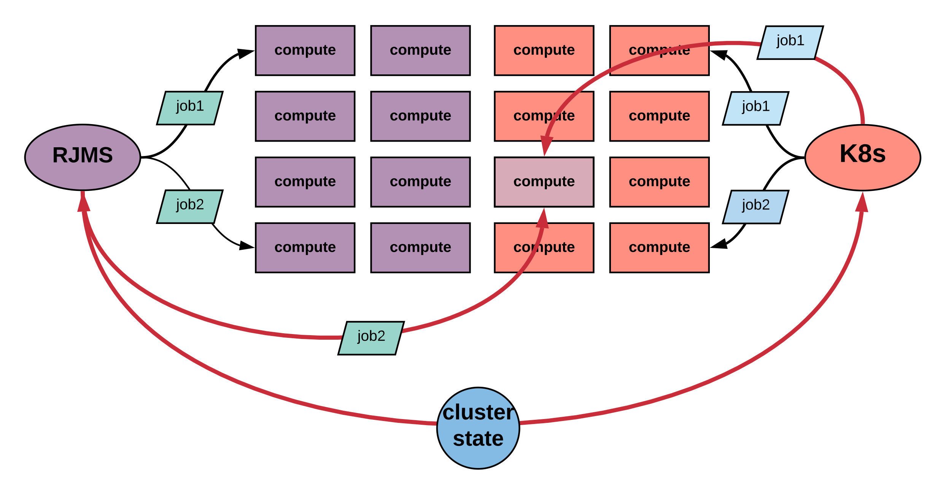
Shared state challenge: conflict

Slide 147
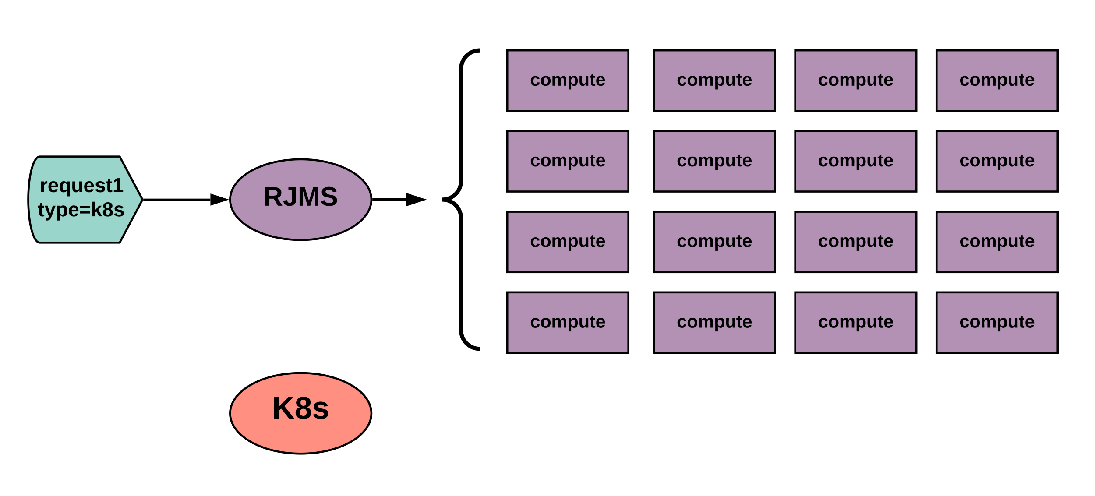
Converged k8s and HPC: subordinate manager

Slide 148
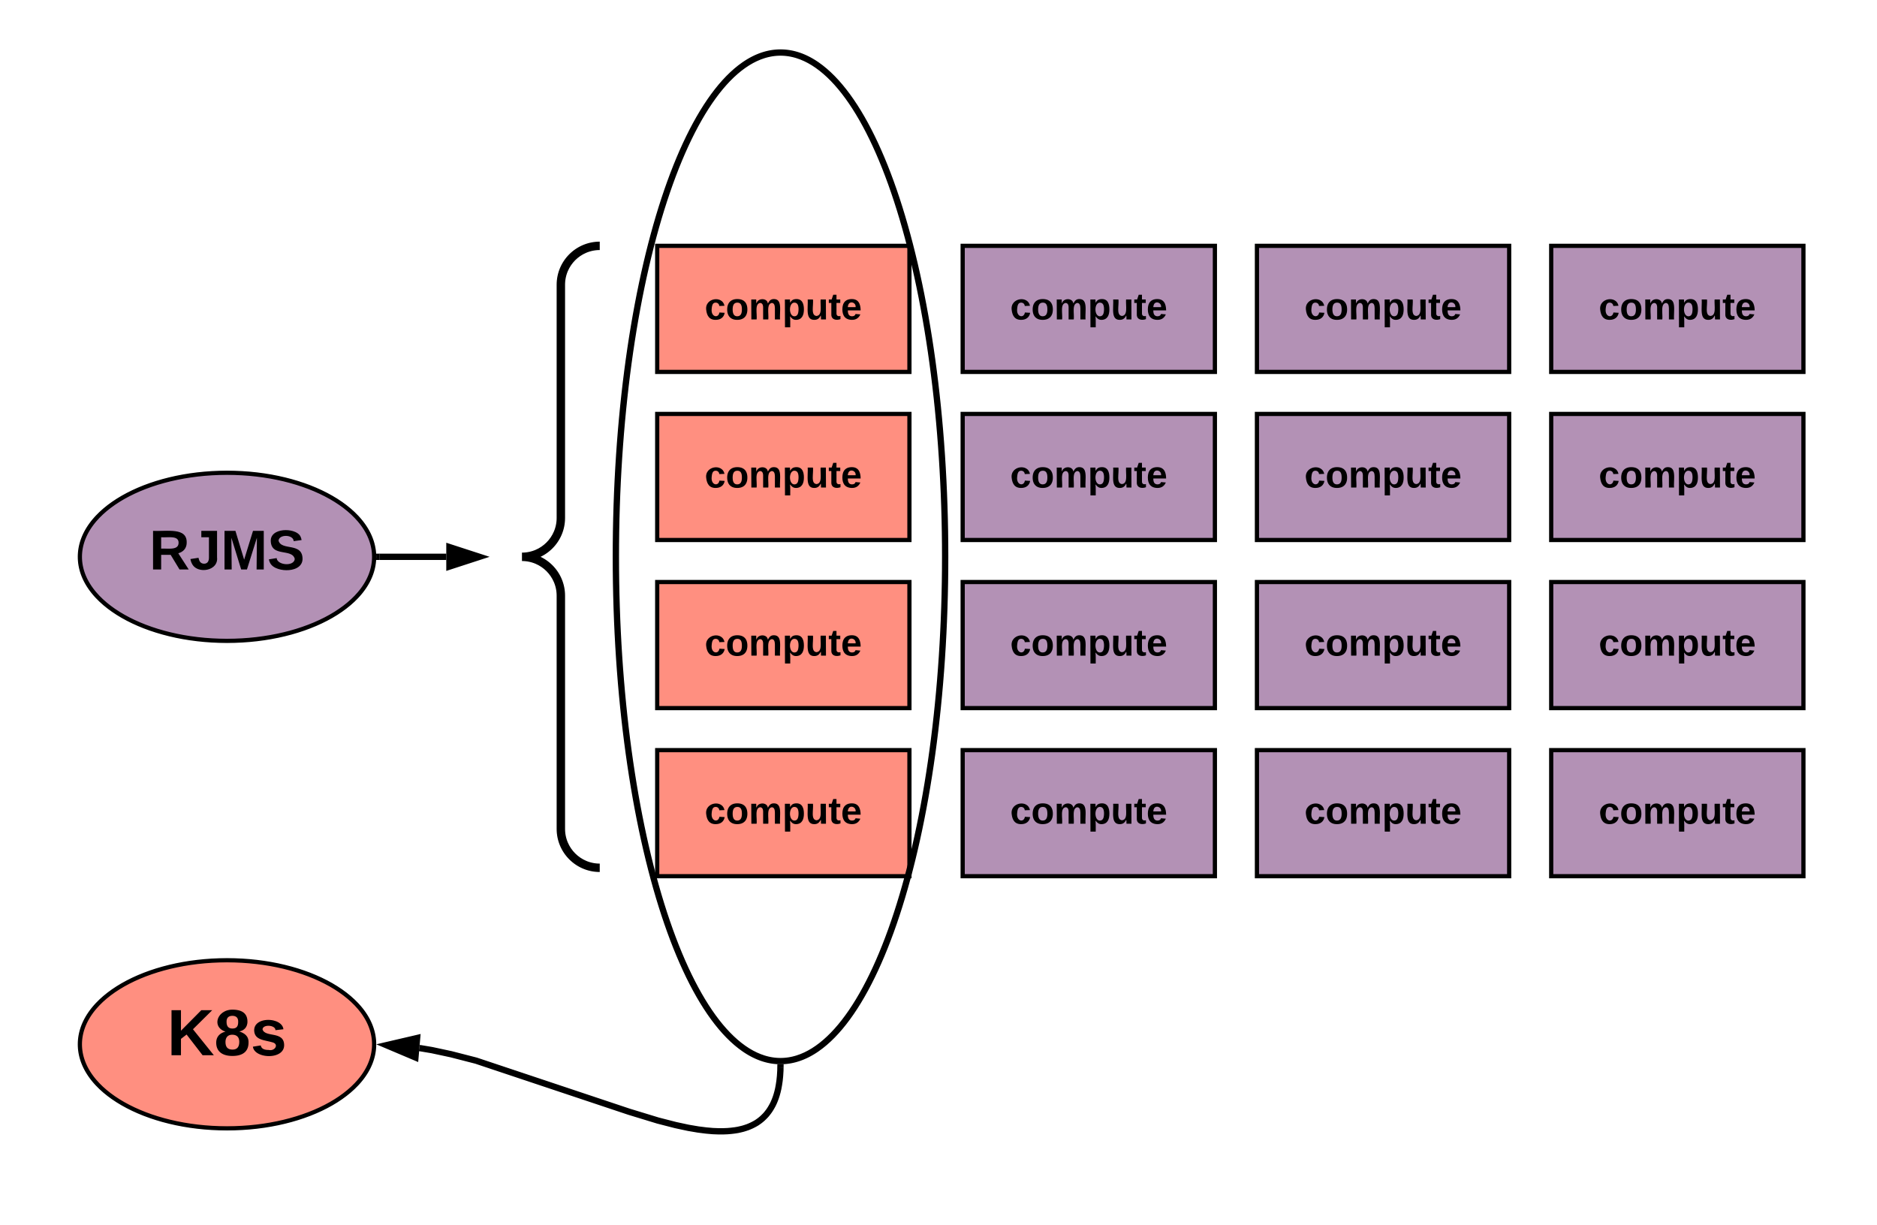
Converged k8s and HPC: subordinate manager

Slide 149
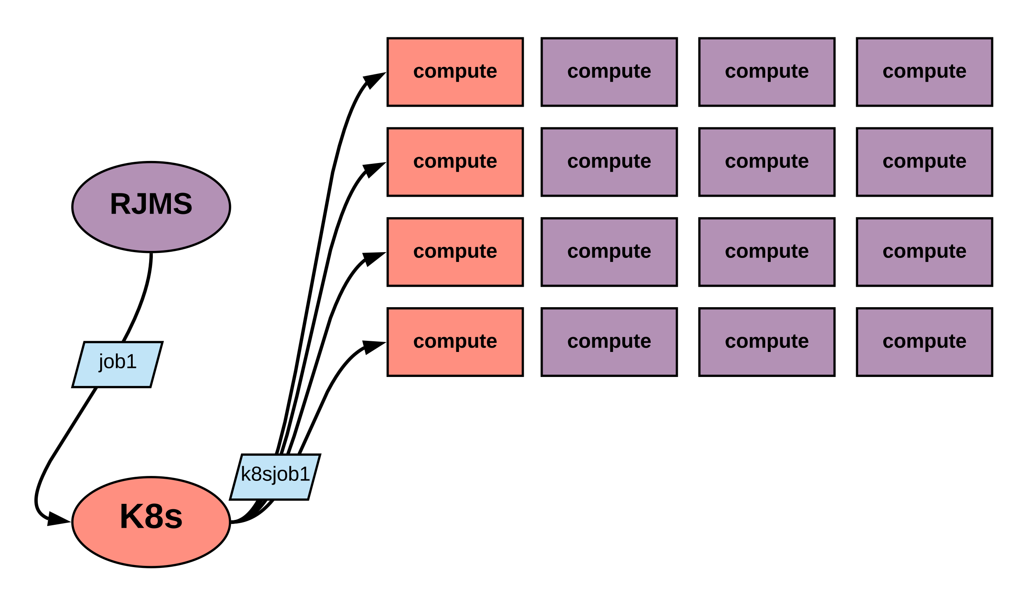
Converged k8s and HPC: subordinate manager

Slide 150
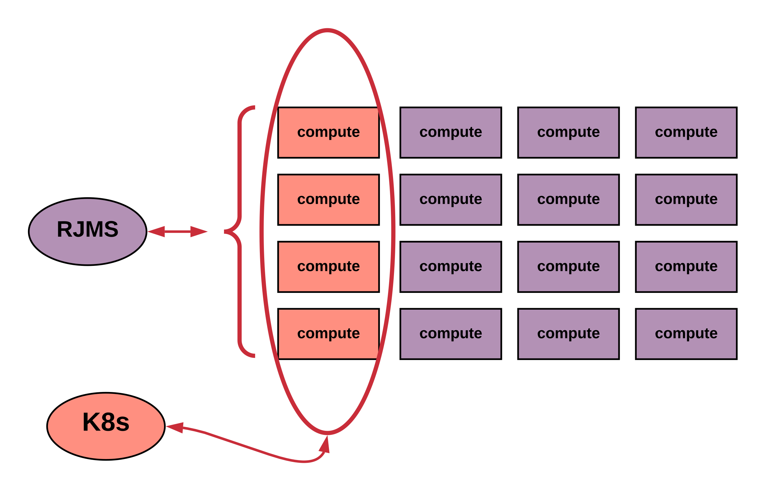
Subordinate manager challenge: resource management

Slide 151
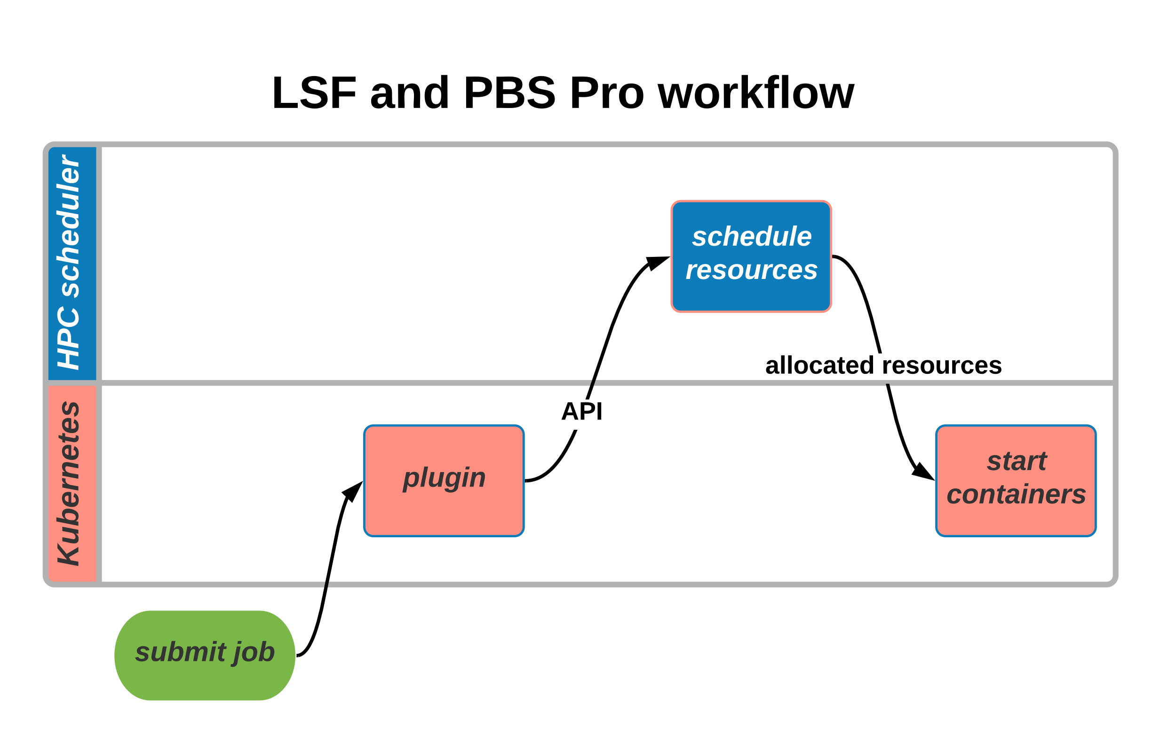
Current investigations in converged k8s and HPC

Slide 152
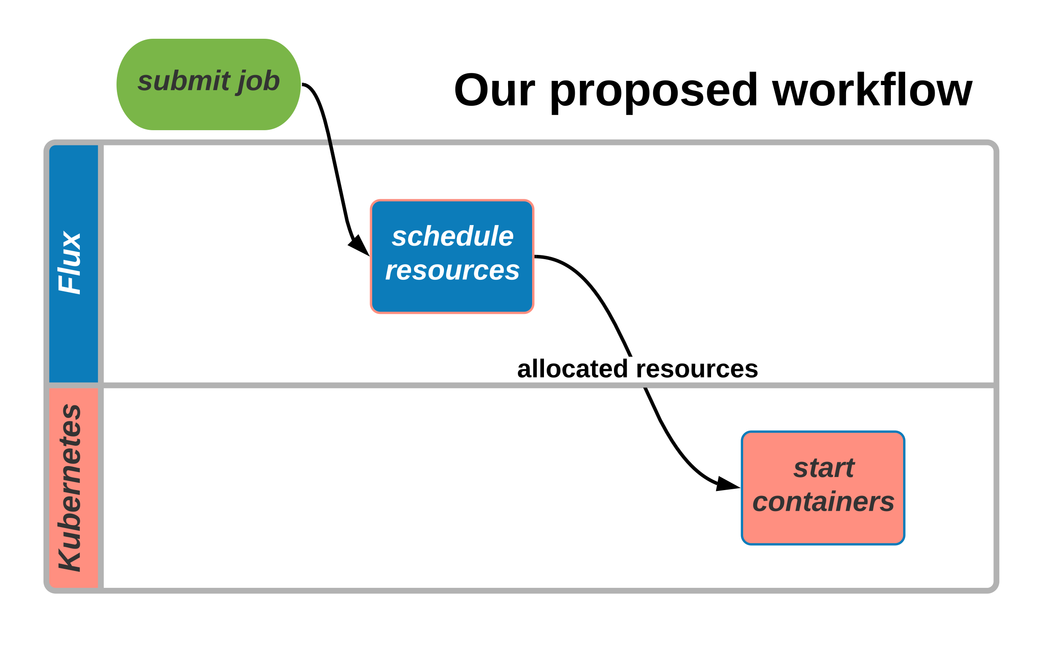
Current investigations in converged k8s and HPC

Slide 153
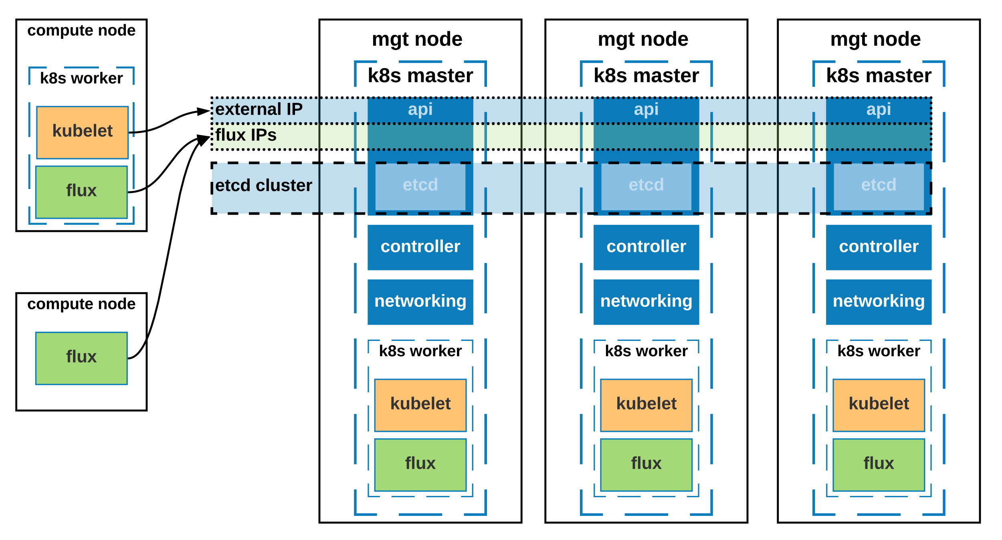
Current investigations in converged k8s and HPC
Run top-level Flux within k8s on master nodes, flux brokers on compute nodes

Slide 154


Flux in the cloud

Slide 155
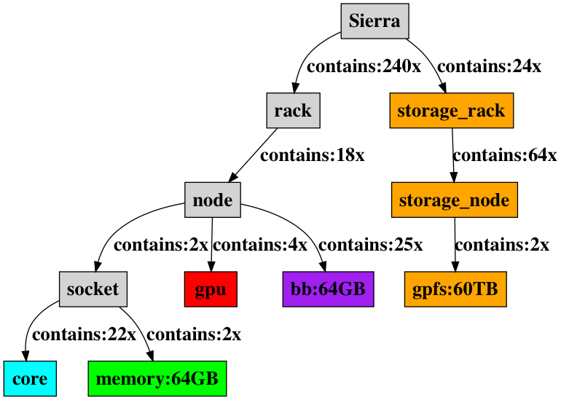
Flux graph-based resource model is powerful
naturally expresses relationships
can be dynamic
naturally expresses hierarchies
facilitates elasticity
opportunities for scheduling research

Slide 156
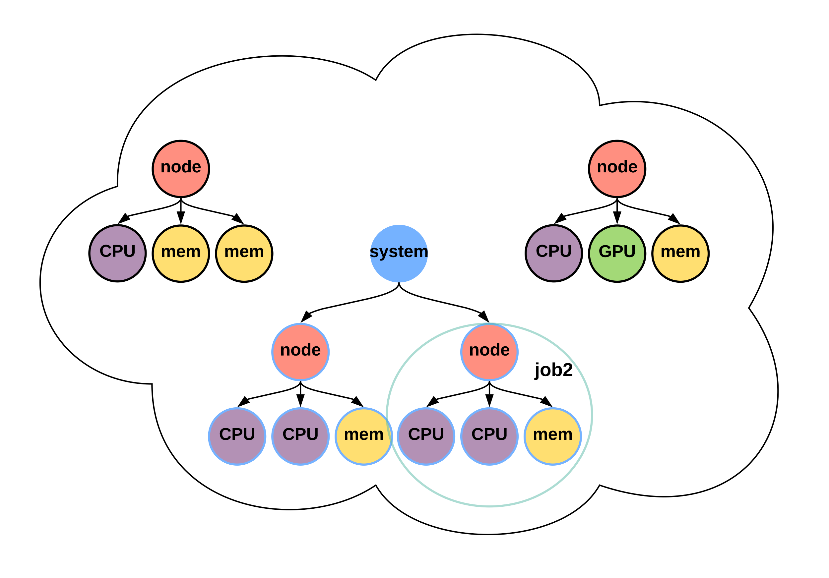
Flux facilitates elasticity
traditional schedulers not designed for dynamic resources
hard to add new relationships without scheduler modification

Slide 157
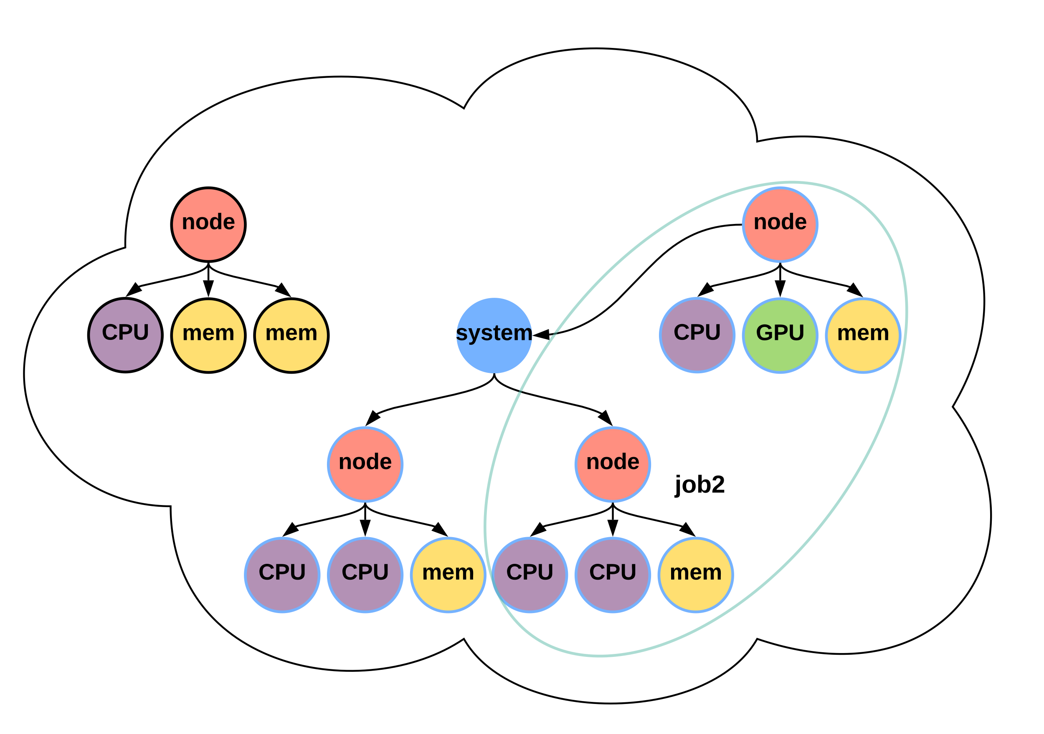
Flux facilitates elasticity
traditional schedulers not designed for dynamic resources
hard to change relationships without scheduler modification

Slide 158
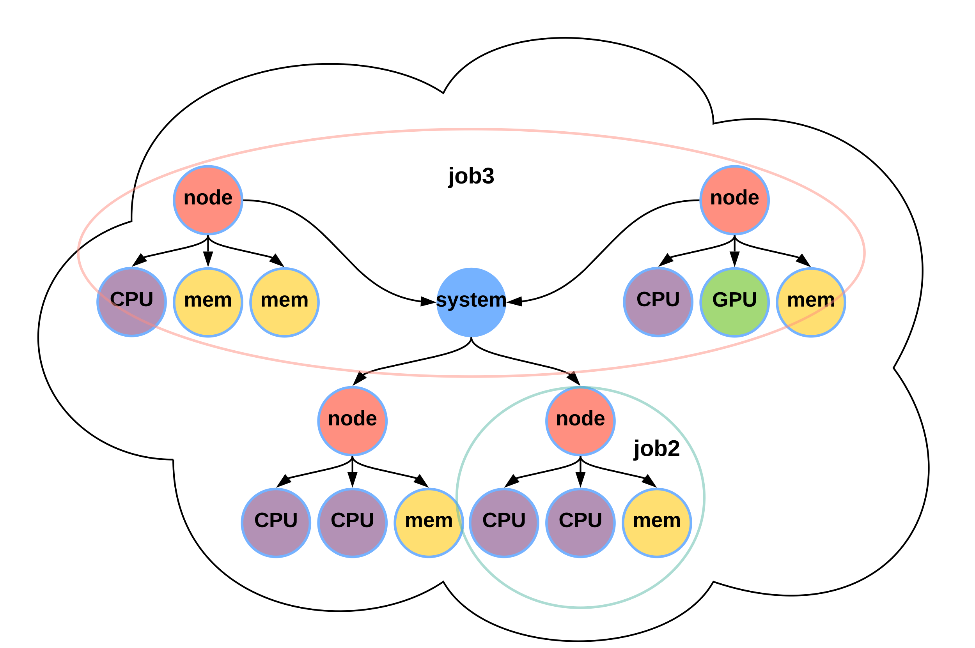
Flux facilitates elasticity
traditional schedulers not designed for dynamic resources
hard to change relationships without scheduler modification

Slide 159
Summary
Containerized workflows are increasingly common in HPC
Flux facilitates converged k8s-HPC: we’re taking the subordinate manager approach
HA Flux-k8s for Exascale at LLNL
We’re putting Flux in the cloud!

Slide 160
Audience feedback
Questions?
Feature requests/workflow support?

Slide 162
Fluxion: A Scalable Graph-Based Resource Model to Multifaceted HPC Scheduling Challenges
Flux Tutorial at ECP Annual Meeting, Feb 6, 2020
Dong H. Ahn, Tapasya Patki, Stephen Herbein, Daniel Milroy, Bruce D’Amora (IBM), Claudia Misale (IBM)

Slide 163
The changes in resource types are equally challenging.
Problems are not just confined to the workload/workflow challenge.
Resource types and their relationships are also becoming increasingly complex.
Much beyond compute nodes and cores...
GPGPUs
Burst buffers
I/O and network bandwidth
Network locality
Power
PFS BW Capacity

Slide 164
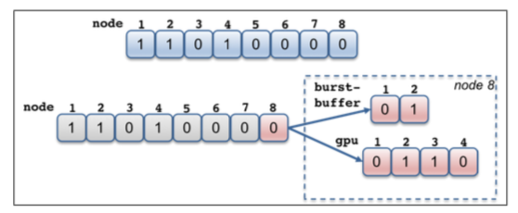
The traditional resource data models are largely ineffective to cope with the resource challenge.
Designed when the systems are much simpler
Node-centric models
SLURM: bitmaps to represent a set of compute nodes
PBSPro: a linked-list of nodes
HPC has become far more complex
Evolutionary approach to cope with the increased complexity
E.g., add auxiliary data structures on top of the node-centric data model
Can be quickly unwieldy
Every new resource type requires new a user-defined type
A new relationship requires a complex set of pointers cross-referencing different types.

Slide 165
Flux uses a graph-based resource data model to represent schedulable resources and their relationships.
A graph consists of a set of vertices and edges
Vertex: a resource
Edge: a relationship between two resources
Highly composable to support a graph with arbitrary complexity
The scheduler remains to be a highly generic graph code.
Containment subsystem
Network connectivity subsystem

Slide 166
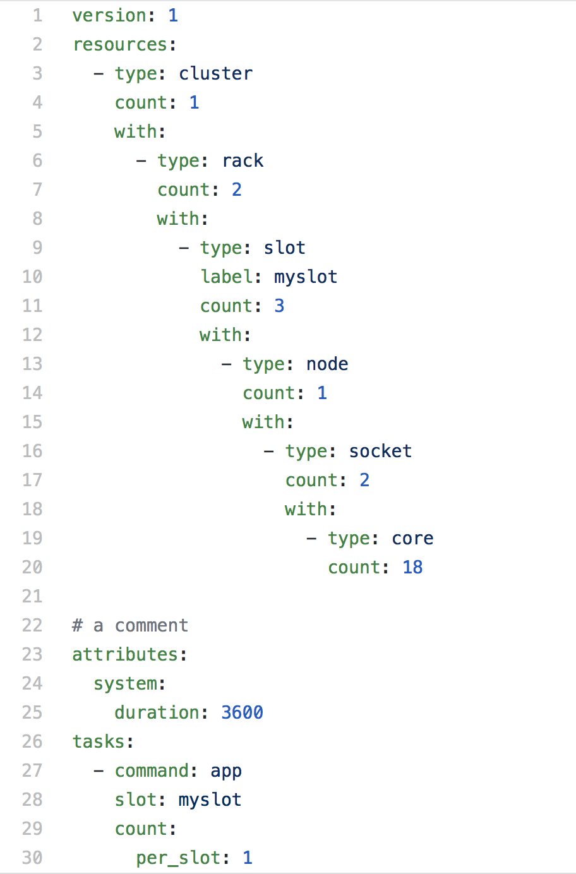
Flux’s graph-oriented canonical job-spec allows for a highly expressive resource requests specification.
Graph-oriented resource requirements
Express the resource requirements of a program to the scheduler
Express program attributes such as arguments, run time, and task layout, to be considered by the execution service
cluster->racks[2]->slot[3]->node[1]->sockets[2]->core[18]
slot is the only non-physical resource type
Represent a schedulable place where program process or processes will be spawned and contained
Referenced from the tasks section

Slide 167
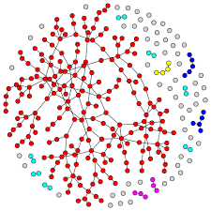
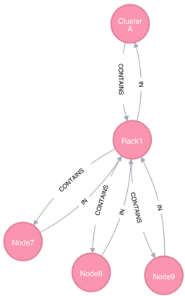
Flux maps our complex scheduling problems into graph matching problems.
Traverse, match and score

Slide 168
We use graph filtering and pruned searching to manage the graph complexity and optimize our graph search.
The total graph can be quite complex
Two techniques to manage the graph complexity and scalability
Filtering reduces graph complexity
The graph model needs to support schedulers with different complexity
Provide a mechanism by which to filter the graph based on what subsystems to use
Pruned search increases scalability
Fast RB tree-based planner is used to implement a pruning filter per each vertex.
Pruning filter keeps track of summary information (e.g., aggregates) about subtree resources.
Scheduler-driven pruning filter update
Containment+Network
Containment
Filtering
Prune filter tracks available node count in aggregate at the subtree
Pruning

Slide 169
Disclaimer
This document was prepared as an account of work sponsored by an agency of the United States government. Neither the United States government nor Lawrence Livermore National Security, LLC, nor any of their employees makes any warranty, expressed or implied, or assumes any legal liability or responsibility for the accuracy, completeness, or usefulness of any information, apparatus, product, or process disclosed, or represents that its use would not infringe privately owned rights. Reference herein to any specific commercial product, process, or service by trade name, trademark, manufacturer, or otherwise does not necessarily constitute or imply its endorsement, recommendation, or favoring by the United States government or Lawrence Livermore National Security, LLC. The views and opinions of authors expressed herein do not necessarily state or reflect those of the United States government or Lawrence Livermore National Security, LLC, and shall not be used for advertising or product endorsement purposes.

Slide 170
Flux Support for Tiered Storage Systems
Anthony Agelastos, Dong H. Ahn, Frank Di Natale, Stephen Herbein, Dan Milroy, Tapasya Patki
February 2020

Slide 171
Tiered Storage in HPC
64x
12x
13x
5x
Source: Lucy Nowell (DOE)

Slide 172
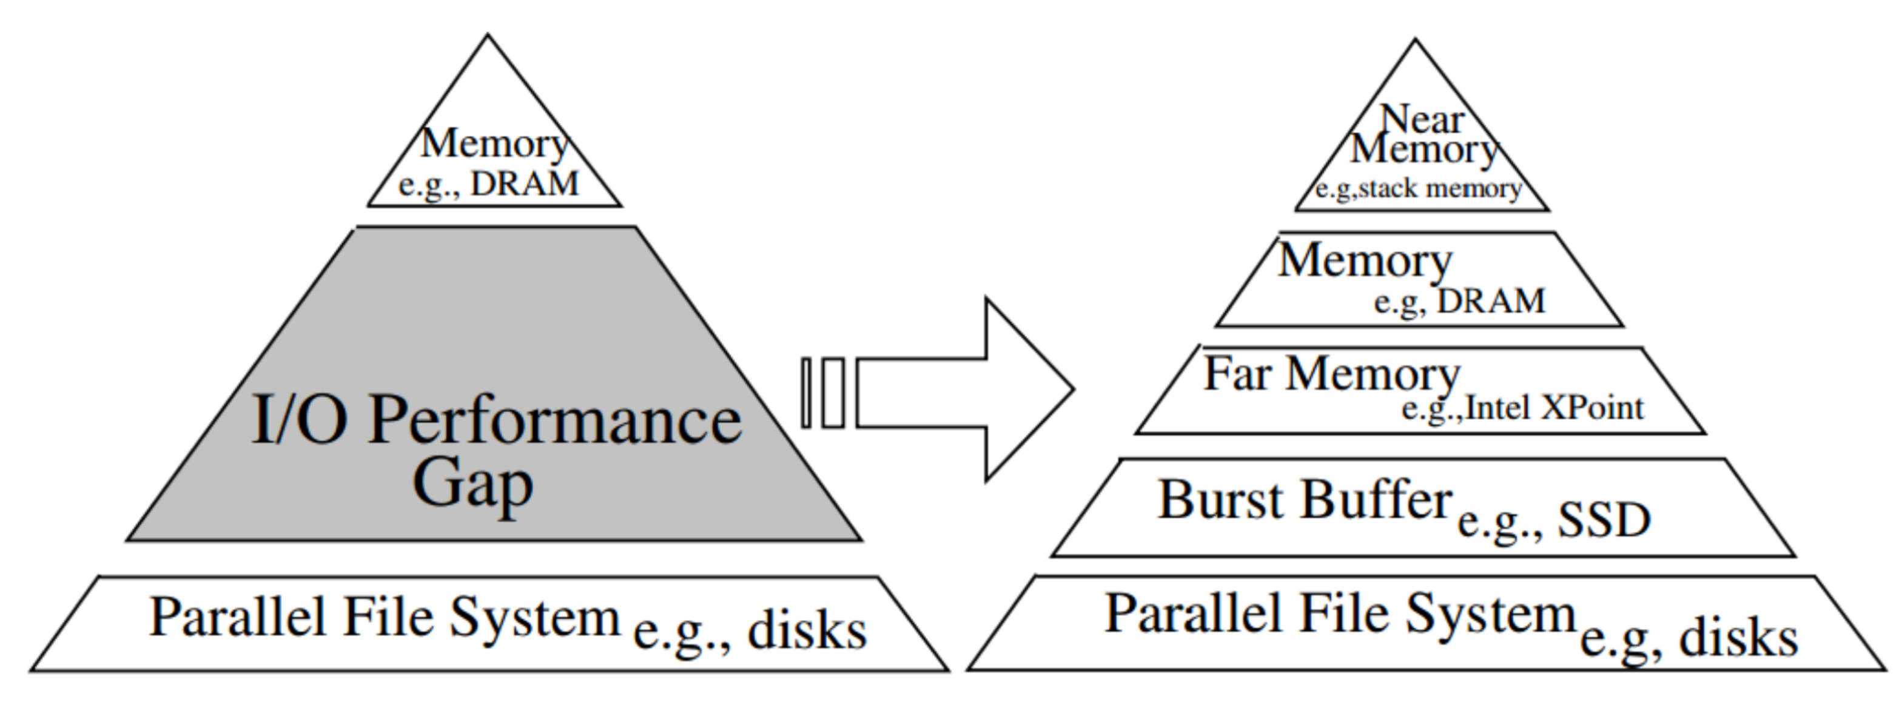
Tiered Storage in HPC
64x
12x
13x
5x
Source: Lucy Nowell (DOE)

Slide 173
Tiered Storage in HPC
64x
12x
13x
5x
Source: Lucy Nowell (DOE)
How can we use the Flux graph-based scheduler to allocate these new storage tiers?

Slide 174
Burst Buffer Architectures
Node-local BB
Remote, shared BB
Filesystem BB
CN
CN
CN
CN
CN
CN
CN
CN
CN
SSD
SSD
SSD
CN
CN
CN
CN
CN
CN
CN
CN
CN
SSD
SSD
SSD
CN
CN
CN
CN
CN
CN
CN
CN
CN
SSD
SSD
SSD
BB
ION
BB
ION
ION
SSD
SSD
SSD
SSD
SSD
IB
SSD
IB
IB
Parallel File System
Parallel File System
Parallel File System
SSD
SSD
SSD
SSD
SSD

Slide 175
Burst Buffers Functionality “Classes”
Cache
acts like an extended OS page cache for a given job or parallel filesystem
all data movement between the BB and the PFS occurs implicitly
Scratch
functions like a /tmp file system for the given node, job, or workflow
Staging
all data movement occurs explicitly for a given job
data movement can occur before and after the job is the running

Slide 176
Node-local Burst Buffer Architecture
Real-World Implementations
IBM’s Sierra (LLNL) and Summit (ORNL)
Use-cases
Scratch
Node-level
Job-level via software like SCR, Intel’s CPPR, or IBM’s BSCFS
Staging
Other notes
Application BB bandwidth and space scales linearly with the number of nodes (i.e., cannot get lots of BB with a single node)
Staging can cause node “lock-in” with a backfilling scheduler
CN
CN
CN
SSD
SSD
SSD
CN
CN
CN
SSD
SSD
SSD
CN
CN
CN
SSD
SSD
SSD
ION
IB
Parallel File System

Slide 177
Remote, Shared Burst Buffer Architecture
Real-World Implementations
Cray DataWarp
Use-cases
Cache
Job-level
Scratch
Workflow or job-level
Staging
Other notes
BB space and bandwidth can scale independently of number of nodes
CN
CN
CN
CN
CN
CN
CN
CN
CN
BB
ION
BB
SSD
SSD
SSD
SSD
SSD
IB
SSD
Parallel File System

Slide 178
Filesystem Burst Buffer Architecture
Real-World Implementations
DDN Infinite Memory Engine
Note: exact architecture details are sparse
Use-cases
Cache
Parallel filesystem level
Staging
Other notes
Even after staging, data is still far away from the nodes, so network congestion can be an issue
CN
CN
CN
CN
CN
CN
CN
CN
CN
ION
IB
Parallel File System
SSD
SSD
SSD
SSD
SSD

Slide 179
Hybrid Burst Buffer Architecture
CN
CN
CN
Real-World Implementations
None
Use-cases
Cache
Job or parallel filesystem level
Scratch
Workflow, job, or node-level
Staging
Other notes
The remote, shared BB could be composed of node-local NVMe devices accessed via RDMA.
SSD
SSD
SSD
CN
CN
CN
SSD
SSD
SSD
CN
CN
CN
SSD
SSD
SSD
BB
ION
BB
SSD
SSD
SSD
SSD
SSD
IB
SSD
Parallel File System
SSD
SSD
SSD
SSD
SSD

Slide 180
Example Tiered Storage Request in Existing Interfaces
Application/Workflow Interfaces
Job launch CLI
bsub -stage "storage=2:in=stage-in.sh:out=stage-out.sh"
Job script directives
#DW jobdw capacity=4TB type=scratch granularity=per-node
#DW jobdw capacity=10TB type=cache
#DW stage_in type=type source=spath destination=dpath
Cons
Vendor-specific directives in your job-scripts
CN
CN
CN
SSD
SSD
SSD
CN
CN
CN
SSD
SSD
SSD
CN
CN
CN
SSD
SSD
SSD
BB
ION
BB
SSD
SSD
SSD
SSD
SSD
IB
SSD

Slide 181
Example Tiered Storage Request in Existing Interfaces
Application/Workflow Interfaces
Job launch CLI
bsub -stage "storage=2:in=stage-in.sh:out=stage-out.sh"
Job script directives
#DW jobdw capacity=4TB type=scratch granularity=per-node
#DW jobdw capacity=10TB type=cache
#DW stage_in type=type source=spath destination=dpath
Cons
Vendor-specific directives in your job-scripts
CN
CN
CN
SSD
SSD
SSD
CN
CN
CN
SSD
SSD
SSD
CN
CN
CN
SSD
SSD
SSD
BB
ION
BB
SSD
SSD
SSD
SSD
SSD
IB
SSD

Slide 182
Example Tiered Storage Request in Flux Jobspec
CN
CN
CN
SSD
SSD
SSD
CN
CN
CN
SSD
SSD
SSD
CN
CN
CN
SSD
SSD
SSD
BB
ION
BB
SSD
SSD
SSD
SSD
SSD
IB
SSD

Slide 183
Co-Scheduling Request
CN
CN
CN
CN
CN
SSD
SSD
SSD
SSD
CN
CN
CN
CN
CN
SSD
SSD
SSD
SSD
CN
CN
CN
CN
CN
SSD
SSD
SSD
SSD
BB
ION
BB
BB
ION
SSD
SSD
SSD
SSD
SSD
SSD
SSD
IB
SSD
SSD
IB

Slide 184
Existing Interfaces
Application/Workflow Interfaces
Job launch CLI
bsub -stage "storage=2:in=stage-in.sh:out=stage-out.sh"
Job script directives
#DW jobdw capacity=4TB type=scratch
#DW jobdw capacity=10TB type=cache
#DW stage_in type=type source=spath destination=dpath
CN
CN
SSD
CN
CN
SSD
CN
CN
SSD
BB
ION
SSD
SSD
SSD
IB
Job script directives operate at the granularity of the entire job, not job-steps

Slide 185
Example Tiered Storage Request in Flux Jobspec
CN
CN
SSD
CN
CN
SSD
CN
CN
SSD
BB
ION
SSD
SSD
SSD
IB

Slide 186
Example Tiered Storage Request in Flux Jobspec
CN
CN
SSD
CN
CN
SSD
CN
CN
SSD
BB
ION
SSD
SSD
SSD
IB

Slide 187
Roadmap for Tiered Storage Support in Flux
Extend jobspec to include stage-in and stage-out attributes
https://github.com/flux-framework/rfc/issues/204
Extend resource to support multiple top-level resource requests
Extend exec to support multiple slots
Extend the IMP to have a two-phase prologue and support vendor BB APIs
launch a prologue across all the nodes and ensure they all succeed before continuing
Using the resource module and simulator, demonstrate representations of capacity and locality for relevant BB architectures

Slide 188
Disclaimer
This document was prepared as an account of work sponsored by an agency of the United States government. Neither the United States government nor Lawrence Livermore National Security, LLC, nor any of their employees makes any warranty, expressed or implied, or assumes any legal liability or responsibility for the accuracy, completeness, or usefulness of any information, apparatus, product, or process disclosed, or represents that its use would not infringe privately owned rights. Reference herein to any specific commercial product, process, or service by trade name, trademark, manufacturer, or otherwise does not necessarily constitute or imply its endorsement, recommendation, or favoring by the United States government or Lawrence Livermore National Security, LLC. The views and opinions of authors expressed herein do not necessarily state or reflect those of the United States government or Lawrence Livermore National Security, LLC, and shall not be used for advertising or product endorsement purposes.

